Slide 1
Bionic Vision Australia
Augmenting intensity to enhance scene structure in prosthetic vision
Chris McCarthy, David Feng and Nick Barnes
NICTA Canberra Research Lab,
Computer Vision Research Group
Australian National University,
College of Engineering and Computer Science
Notes:
1

Slide 2
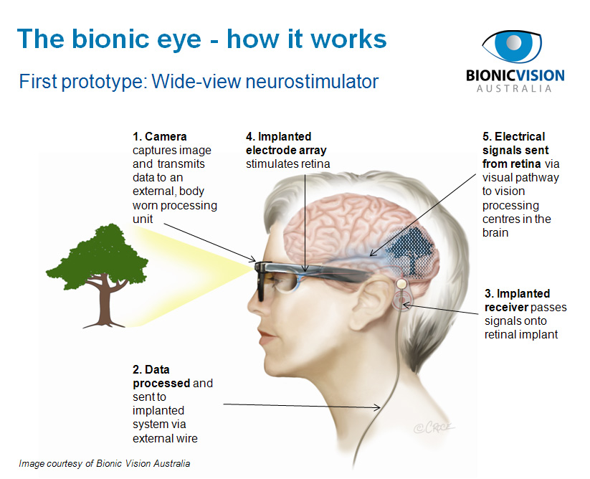
HEADING
Sub Heading
Level 1 text
Notes:
2

Slide 3
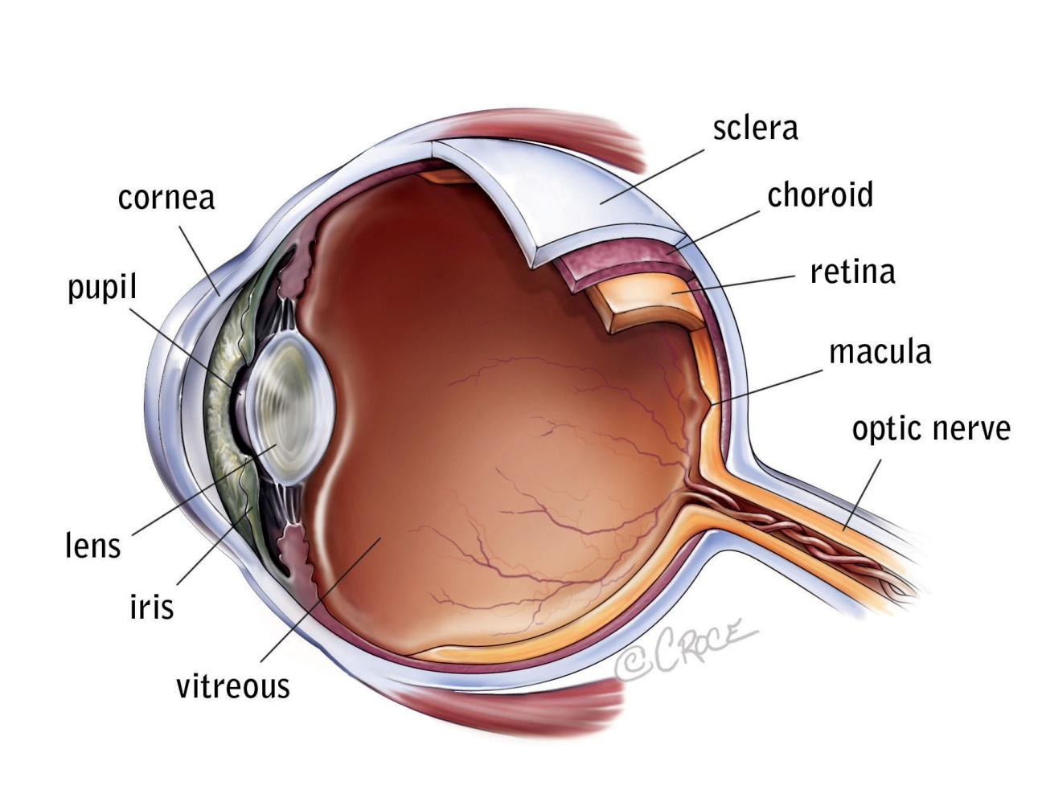
Implant placement in eye
Wide-View array:
supra-choroidal
High-Acuity
array:
epi-retinal

Slide 4
Phosphene vision
Induced perception of light by means other than light entering the eye
Notes:
4

Slide 5
Mobility with prosthetic vision
Expectations:
move freely, avoid obstructions, and orientate
Challenges:
limited bandwidth:
number of electrodes, dynamic range, refresh rate
Strategy:
Vision processing algorithms and alternative visual representations to improve mobility outcomes
Notes:
5

Slide 6
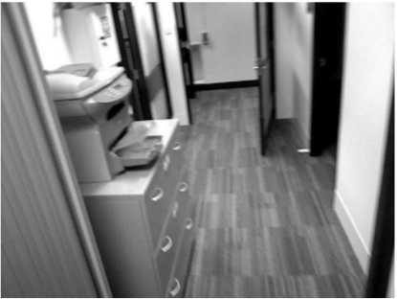
Vision processing
Simplest vision processing scheme:
down-sample the intensity image:
Notes:
6

Slide 7
Vision processing
We propose:
stimulate to emphasise structurally significant features:
Notes:
7

Slide 8
Mobility with prosthetic vision
Previously tested vision processing schemes:
Intensity-based: phosphene brightness conveys scene luminance
[Cha et al VR 1992, Dagnelie et al, JNE 2007]
Saliency: dedicated phosphenes cue salient features
[Parikh et al, JNE 2010,2013]
Depth-based: phosphene brightness conveys surface proximity
[Barnes et al, ARVO 2012]
Surface fitting: enhanced obstacle perception by extracting ground plane
[McCarthy et al, ARVO 2012]
Notes:
8

Slide 9
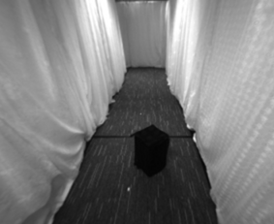
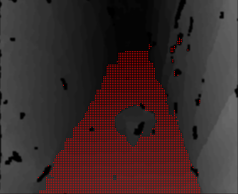
Mobility with prosthetic vision
Previously: augmented depth
[McCarthy et al, ARVO 2012, EMBC 2011]
Notes:
9

Slide 10
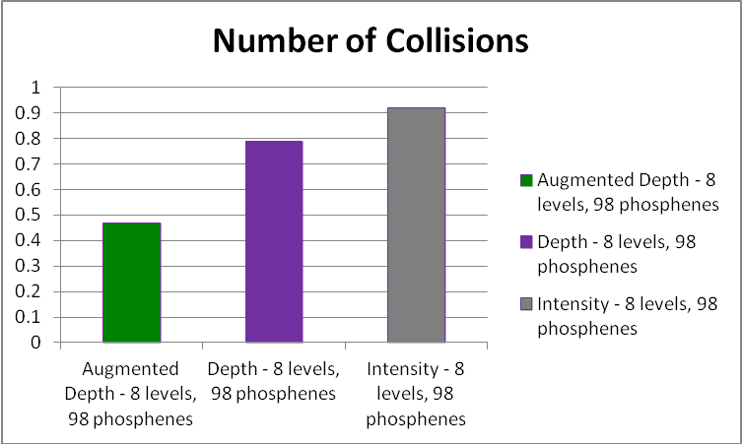
Mobility with prosthetic vision
Previously: augmented depth
[McCarthy et al, ARVO 2012]
Notes:
10

Slide 11
Mobility with prosthetic vision
Assumptions and limitations:
Intensity-based: high-contrast surface boundaries
Intensity + cueing: appearance-based saliency
Depth-based: perceivable depth change across boundaries
Augmented Depth: explicit surface fitting/segmentation
Notes:
11

Slide 12
Mobility with prosthetic vision
Key outcomes:
Augmentations that emphasise obstructions can significantly improve performance
Acceptable to participants
Limitations:
Relies on accurate surface-fit and segmentation
Removes potentially useful information from the scene
Does not easily generalise to other activities of daily living
Notes:
12

Slide 13
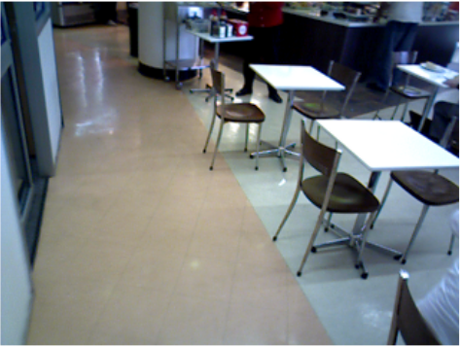
New proposal: the perturbance map
Rationale:
Stimulate conservatively and selectively, but maintain naturality
Emphasise regions of “structural interest”
Notes:
13

Slide 14
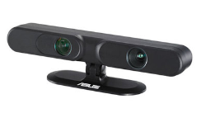
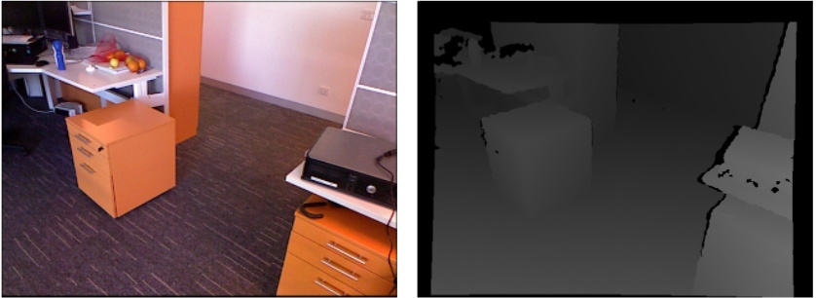
Method
Algorithm inputs:
A dense disparity (ie., inverse depth) image
We use (but are not limited to!) an Asus Xtion Pro RGB-D sensor
Notes:
14

Slide 15
Method
The perturbance map:
Weight the extent of surface orientation change in a local region w.r.t surrounding regions
Notes:
15

Slide 16
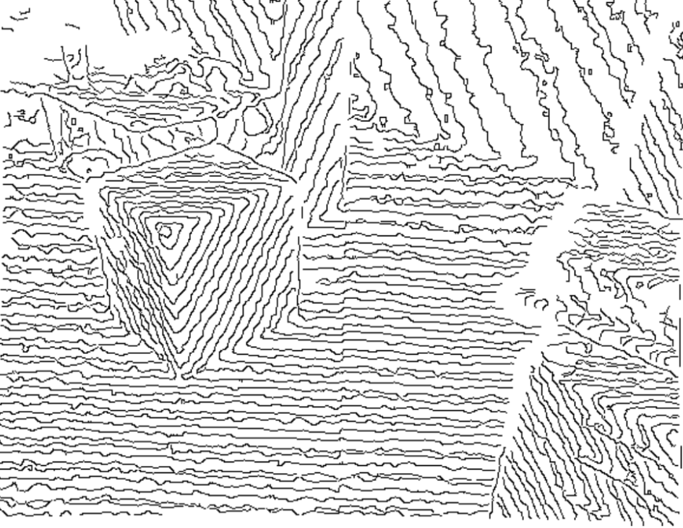
Method
Algorithm assumptions:
Iso-disparity contour extraction: the boundaries between level sets of disparity
Notes:
16

Slide 17
Method
Step 1: extract local disparity gradients
If disparities are highly quantised, disparity contours may be used instead
Notes:
17

Slide 18
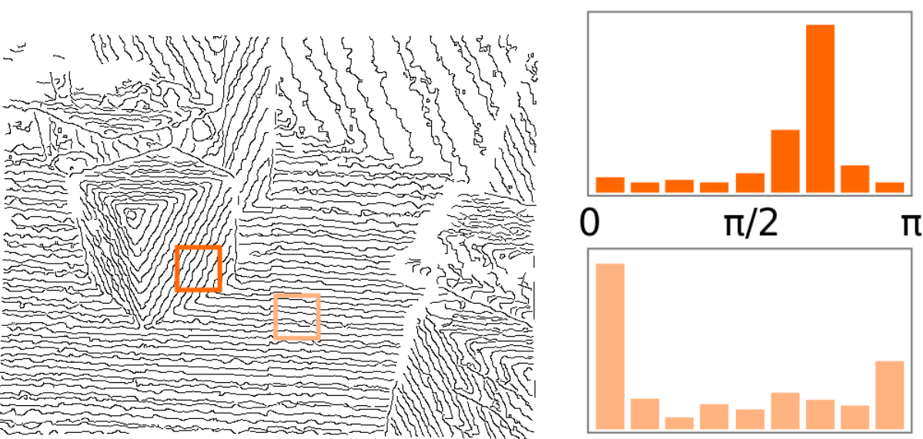
Method
Step 2: local surface orientations
Histogram orientations of local gradient vectors (or iso-disparity linear segments)
Notes:
18

Slide 19
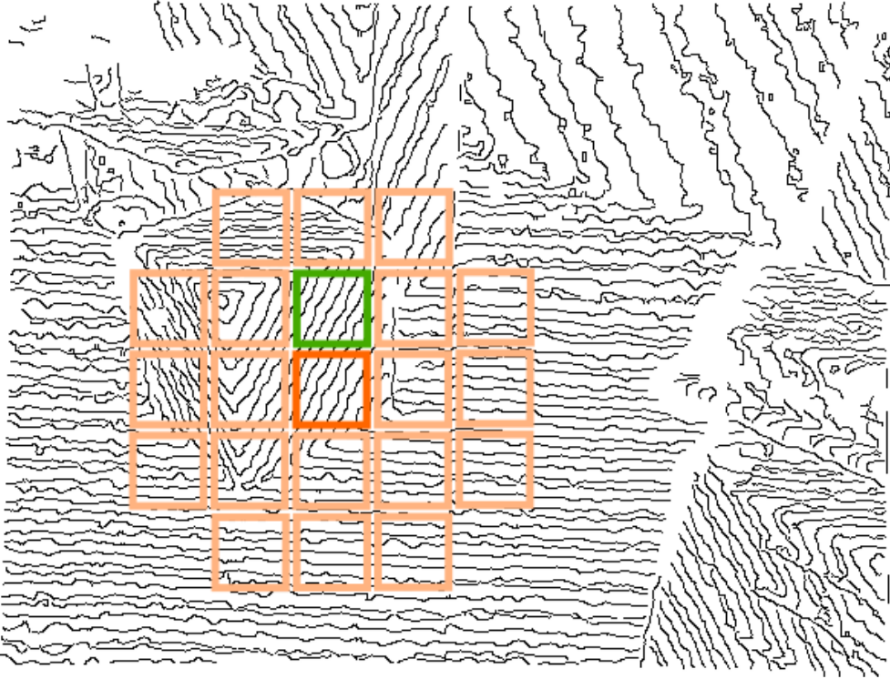
Method
Step 3: fixed scale window comparison
Notes:
19

Slide 20
Method
Step 3: fixed scale window comparison
Notes:
20

Slide 21
Method
Step 3: fixed scale window comparison
Histogram non-overlap
Notes:
21

Slide 22
Method
Step 3: fixed scale window comparison
Notes:
22

Slide 23
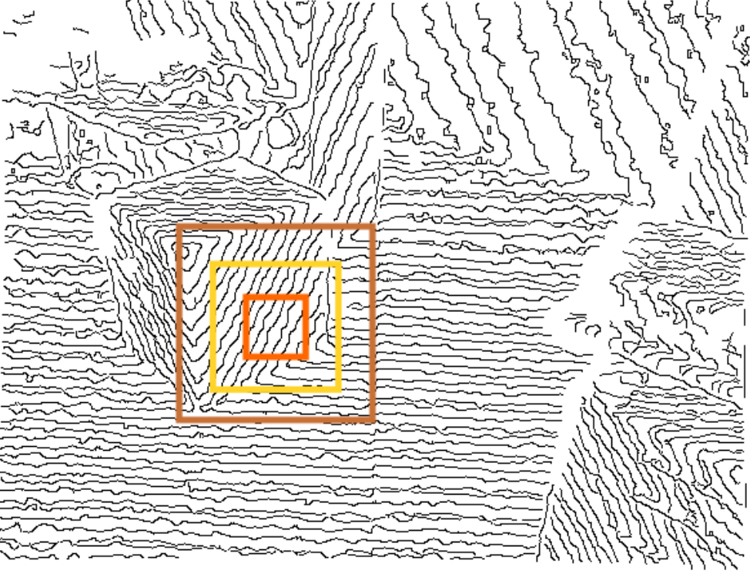
Method
Step 4: multi-scale perturbance calculation:
Combine perturbance scores across scales:
weighted average based on number of iso-disparity pixels in each window
Notes:
23

Slide 24
Method
Post processing: special cases
fronto-parallel surfaces:
we explicitly detect fronto-parallel surfaces via the ratio of iso-disparity contour pixels to total valid disparity values
occlusion boundaries (ie., depth discontinuities):
We threshold local gradient magnitude estimates to determine where occlusion boundaries exist
Notes:
24

Slide 25
Results: the perturbance map live
Original image
Perturbance map

Slide 26
Results
Quantitative: ground surface boundary recall:
Compare thresholded perturbance maps with ground plane fitting
Notes:
26

Slide 27
Results
Quantitative: ground surface boundary recall:
Notes:
27

Slide 28
Results
Quantitative: ground plane mislabel rate:
Notes:
28

Slide 29
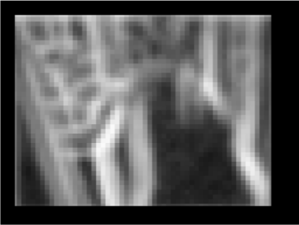
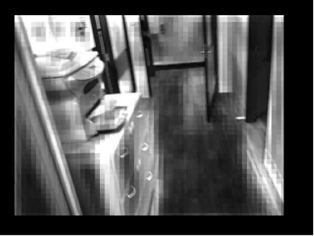
Augmented Intensity
Scale intensity image by the perturbance map
I(p)
P(p)
I*(p)
Notes:
29

Slide 30
Visual representation
Perturbance map
Augmented Intensity
Notes:
30

Slide 31
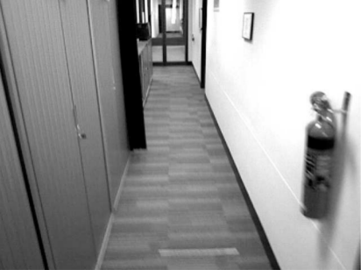
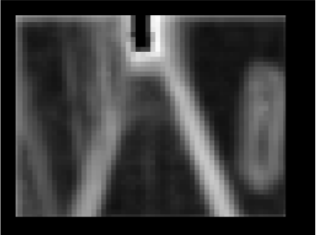
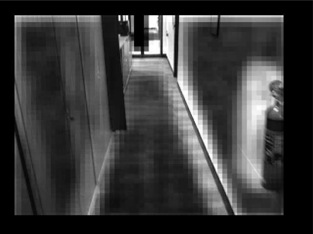
Augmented Intensity
Sample results
Perturbance map
Augmented intensity
Notes:
31

Slide 32
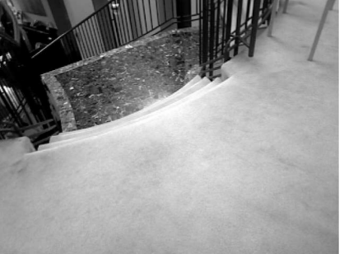
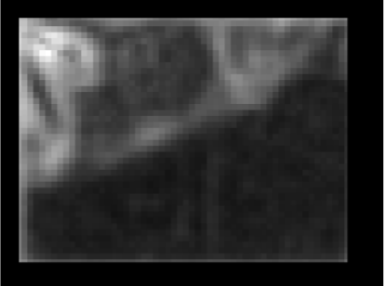
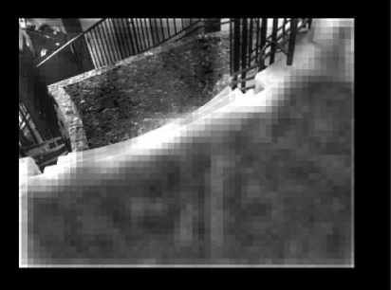
Augmented Intensity
Sample results
Perturbance map
Augmented intensity
Notes:
32

Slide 33
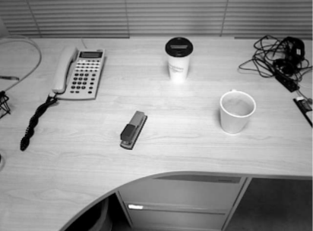
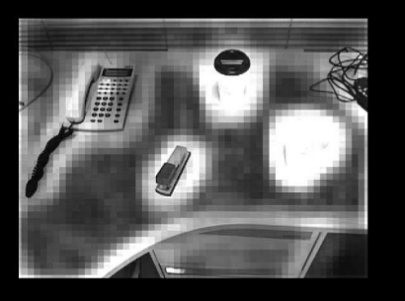
Augmentation
Sample results
Perturbance map
Augmented intensity
Notes:
33

Slide 34
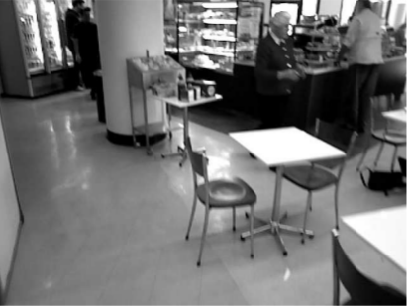
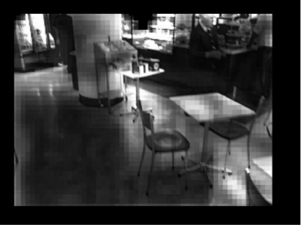
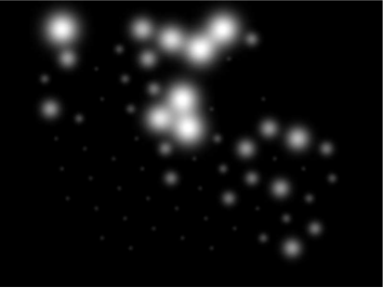
Visual representation
Qualitative evaluation in simulated prosthetic vision
98 phosphene hexagonal grid (8 brightness levels)
Notes:
34

Slide 35
Visual representation
Comparisons in simulated prosthetic vision
98 phosphene hexagonal grid (8 brightness levels)
Original intensity
Intensity phosphenes
Notes:
35

Slide 36
Visual representation
Qualitative evaluation in simulated prosthetic vision
98 phosphene hexagonal grid (8 brightness levels)
Augmented Intensity
Augmented phosphenes
Notes:
36

Slide 37
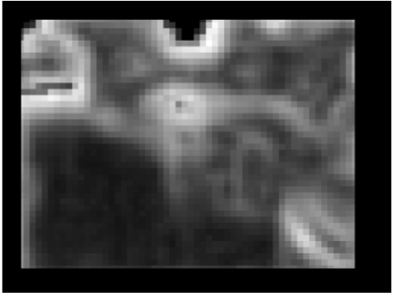
Intensity vs Augmented Intensity
intensity
augmented intensity
Notes:
37

Slide 38
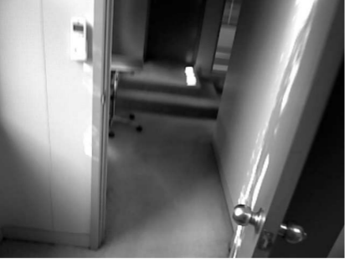
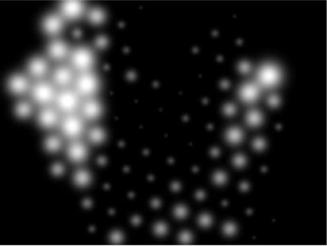
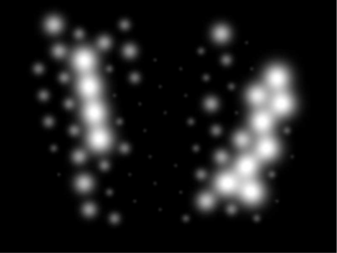
Intensity vs Augmented Intensity
intensity
augmented intensity
Notes:
38

Slide 39
Intensity vs Augmented Intensity
intensity
augmented intensity
Notes:
39

Slide 40
Intensity vs Augmented Intensity
intensity
augmented intensity
Notes:
40

Slide 41
Visual representation II
Augment Depth with perturbance map
Scale disparity by perturbance map
[McCarthy et al, EMBC 2013]
Notes:
41

Slide 42
Results: perturbance vs intensity
intensity-based
perturbance-based
Notes:
42

Slide 43
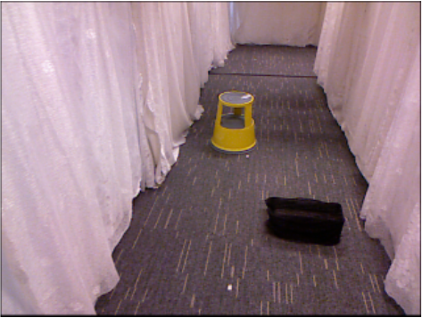
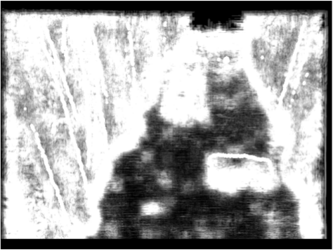
Results: perturbance vs intensity
perturbance-based
intensity-based
Notes:
43

Slide 44
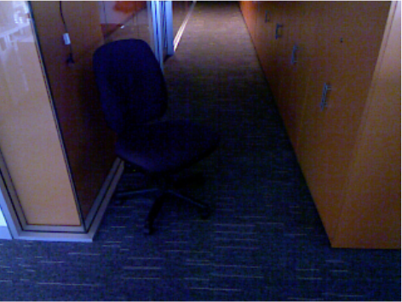
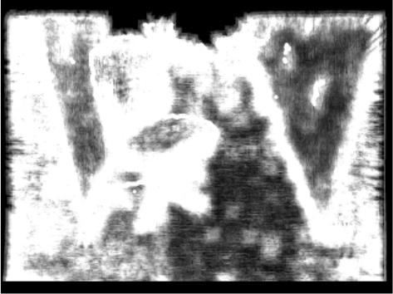
Results: perturbance vs intensity
intensity-based
perturbance-based
Notes:
44

Slide 45
Summary
Perturbance map emphasises structure
Enhances structural change w.r.t surrounding smooth surfaces
Preserves natural variation providing rich visual representation
Boundary preservation over surface modelling
Future work:
Mobility trials: in simulation and with patients
Re-formulate augmentation in contrast space
Notes:
45

Slide 46
HEADING
Acknowledgements
Simulation software: Paulette Lieby, Adele Scott, Ashley Stacey
Funding:
BVA: Australian Research Council (ARC) Special Research Initiative (SRI) in Bionic Vision Science
NICTA: Australian Government, Dept. Broadband, Communications and the Digital Economy and the ARC ICT Centre of Excellence program
Notes:
46

