Slide 1
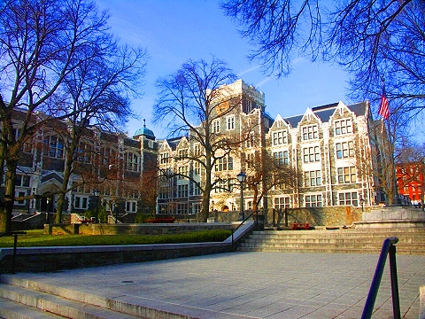
“Visual Semantic Parameterization - To enhance blind user perception for indoor navigation”
Samleo L . Joseph,
Chucai Yi,
Fei Yan,
Jizhong Xiao &
YingLi Tian
Dept. of Electrical Engineering
Grove school of engineering
The City College of New York
New York, NY, USA.

Slide 2
Background
Robot navigation
In Robotics, Precise model of the relationship between control parameters and body kinematics is designed as a motion model
This is Influenced by the physical constraints in its environment
Human Navigation
Human acquires control parameters that yield safe navigation from the physical constraints of the environment.
If these constraints change, a Human may adapt to optimize those parameters until path is stabilized again.
Blind Human Navigation
Actively adapt to the environmental parameters, provided these constraints are precisely nurtured, in a blind perceivable manner.
Our Focus
this research focus on enforcing those constraints required for safe navigation of a visually impaired person using crowdsourcing

Slide 3
Objective
Conceivable wearable navigation system
What is visual semantic parameterization?
Purpose
Conceive floor-plan map – semantic information
Location awareness to the user
Track the path of the user on the map
Update the map with quantitative & qualitative information
Feedback – correct travel direction to the user
Wearable sensors
Camera (head-mounted)
Kinect (waist-mounted)

Slide 4
Challenges to design a navigation framework utilizing a floor plan
How to design a schema that nurtures the constraint of an environment required for a blind navigation?
How to emphasize the semantic cues inferred from a floor plan to design a meaningful schema?
Can the proposed schema be created using analogous floor-plans of all the buildings in the world?
How to present the travel distance in terms of blind understandable units to notify the intended travel route?
How to predict a human walk and plan a path by avoiding the obstacles on the way towards the destination?

Slide 5
Literature review
Mixed-initiative modeling of navigation:
manually feeding the constraints in the environment
then initiating the navigation process.
Apostolopoulos and Fallah et al (2012) Navatar
requires collection of building map from owners
manual preprocessing to annotate landmarks for navigation
Lee et al (2010) - Building information model
User door points to generate a graph plan
Karimi et al (2011)
interpolation scheme - spatial data on the end nodes of hallway
Lorenz et al (2006)
interface nodes, provided by a graph hierarchy algorithm
Notes:
The advantage of this mixed- initiative model is to utilize a powerful desktop computer that can augment a map with meaningful information within a short timespan.
The main drawback with all these approaches are that the building information needs to be collected from the building owners and its meaningful information needs to be manually integrated into their system in order to generate a metric map for the indoor navigation

Slide 6
Problem formulation
Problem - Building a map from an unknown environment
Requires - acquiring the surroundings with sensors that approximately senses the environment in order to build a map.
Robotics SLAM - the data acquired by sensors traversing along the entire environment
Our approach:
Infer meaningful information in the snapshot of a floor-map
updated or corrected when the human-user traverses to the corresponding locations on that map.
Maintain database - Semantic schema

Slide 7
System overview

Slide 8
Floor plan parameterization
Contextual information from landmarks
Infer its meaningful information
Snapshot of floor-plan, signage, room numbers on the door, etc are parameterized to infer its meaningful information.
To enhance blind user perception for indoor navigation

Slide 9
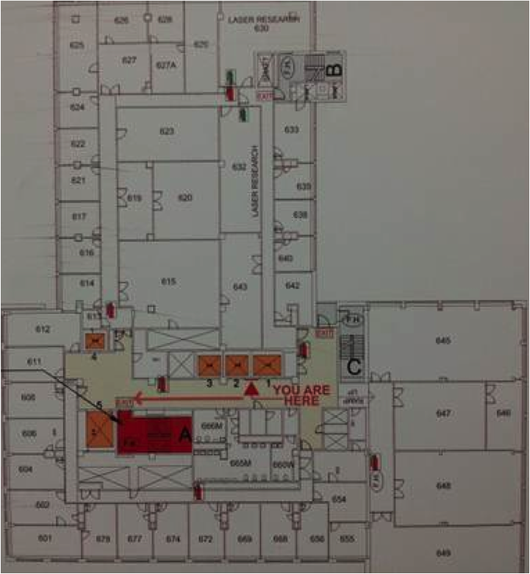
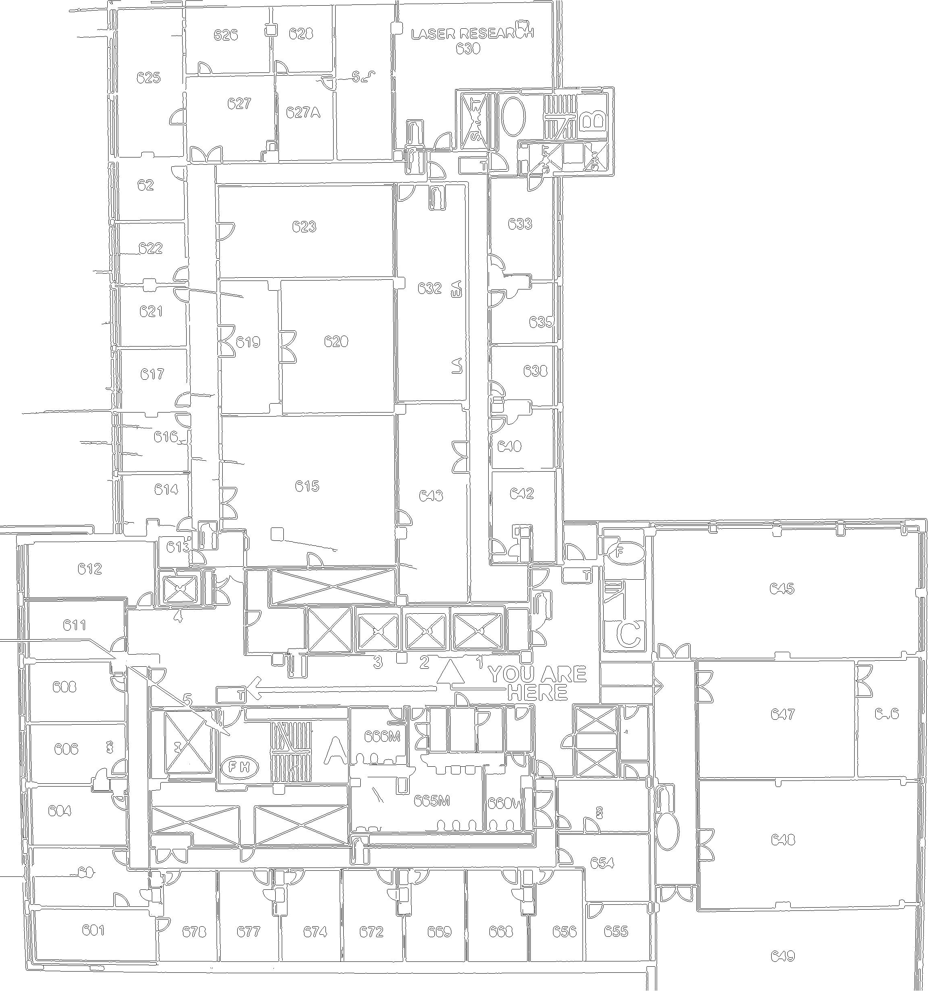
Floor plan parameterization
Fig(a) - Snapshot of floor plan
Fig(b) - Corresponding Edge map

Slide 10
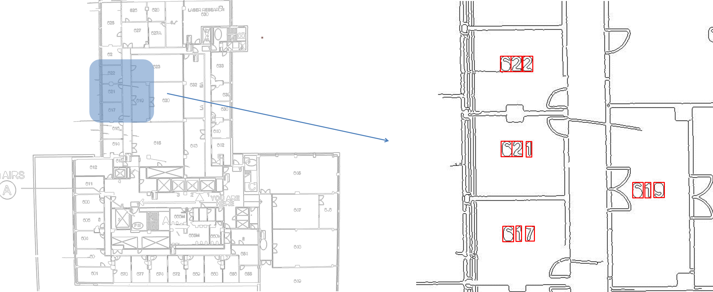
Floor plan parameterization
The boundary group obtained from edge map

Slide 11
Floor plan parameterization
Detected regions of room numbers (red)
Notes:
Detected regions of room numbers marked in red

Slide 12
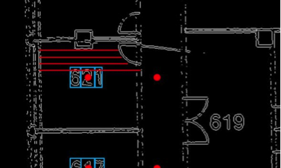
Floor plan parameterization
D-Shape detection is performed to localize the door position. According to the room number region and door position, we could calculate the point in hall path.

Slide 13
Semantic schemata
Purpose - organize the knowledge acquired on the floor plans
Central processing unit of our proposed system
Perceive a mental mapping of the environment.
Room number labels and its entry points on the hallway boundaries - generate a graph of nodes
Precise plan or schema is designed using those nodes

Slide 14
Human motion parameterization
Purpose - obstacle avoidance problem
Solved by a real-time path finding in local map
Fajen et al. - imitate how humans walk towards the goal by avoiding obstacles using behavioral dynamics
short term goal - passing room numbers on the way - confirm

Slide 15
Human motion parameterization
Notes:
Obstacle on the walls are door corners

Slide 16
Pathing map parameterization
Purpose – to notify the travel distance information
Required - an accurate estimation of the current user location
Guidance module to present the travel route
Enforce physical constraints required for safe navigation of a visually impaired person
Inform the user to enhance the Blind perception of environment

Slide 17
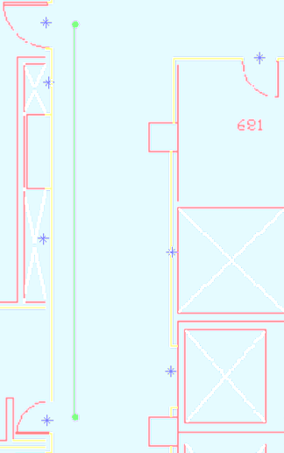
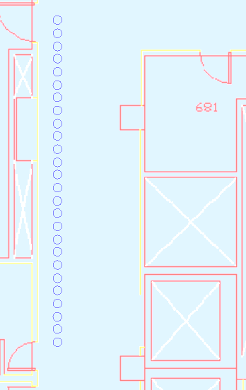
Results
Intended travel route (green line)
Travel route provided by Human motion model
(blue circles)

Slide 18
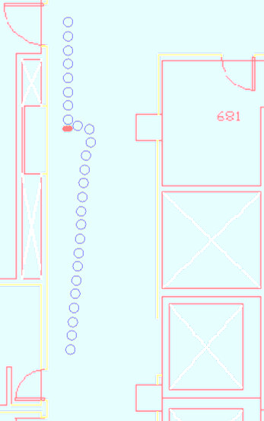
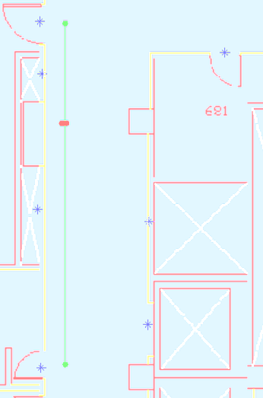
Results
Intended travel route (green line) with obstacles (Red)
Human motion model repels from the obstacle (red) and alters the travel path towards goal.

Slide 19
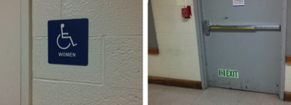
Results
Snapshot of a landmark scene
Extracted visual cues
Notes:
To confirm the user location

Slide 20
Conclusion and future trends
Enhance understanding of the surrounding environment.
Future work
completely functional navigation device to assist the blind user
test the proposed approach with a blind subject after integrating sensors such as Kinect (for accurate obstacle detection), speech module, tactile feedback, etc.
integrate crowd-sensing effects to provide awareness to the blind user based on the evidence of some interesting pattern inferred using the crowd analytics.
Notes:
current location of the blind user is inferred based on the visual cue

Slide 21
Reference
[1] Ilias Apostolopoulos, Navid Fallah, Eelke Folmer, and Kostas E. Bekris, “Integrated online localization and nav- igation for people with visual impairments using smart phones,” in International Conference on Robotics and Automation (ICRA), 2012.
[2] Navid Fallah, Ilias Apostolopoulos, Kostas Bekris, and Eelke Folmer, “The user as a sensor: navigating users with visual impairments in indoor spaces using tactile landmarks,” in Proceedings of the 2012 ACM annual con- ference on Human Factors in Computing Systems, 2012.
[3] Jin-kook Lee, Charles M Eastman, Jaemin Lee, Matti Kannala, and Yeon-suk Jeong, “Computing walking dis- tances within buildings using the universal circulation network,” Environment and Planning B: Planning and Design, vol. 37, no. 4, 2010.
[4] Hassan A. Karimi, Universal Navigation on Smart- phones, Springer, 2011.
[5] BernhardLorenz,HansOhlbach,andEdgar-PhilippStof- fel, “A hybrid spatial model for representing indoor envi- ronments,” Web and Wireless Geographical Information Systems, 2006.
[6] Brett R. Fajen, William H. Warren, Selim Temizer, and Leslie Pack Kaelbling, “A dynamical model of visually- guided steering, obstacle avoidance, and route selection,” International Journal of Computer Vision, vol. 54, no. 1- 3, 2003.
[7] A.R. Pratama, Widyawan, and R. Hidayat, “Smartphone- based pedestrian dead reckoning as an indoor positioning system,” in 2012 International Conference on System En- gineering and Technology (ICSET), 2012.
[8] YingLi Tian, Xiaodong Yang, Chucai Yi, and Aries Arditi, “Toward a computer vision-based wayfinding aid for blind persons to access unfamiliar indoor envi- ronments,” Machine Vision and Applications, pp. 1–15, 2012.
[9] Chucai Yi and YingLi Tian, “Text string detection from natural scenes by structure-based partition and grouping,” IEEE Transactions on Image Processing, vol. 20, no. 9, pp. 2594–2605, 2011.

Slide 22
Thank you
Discussions / Questions ?

