Slide 1
ATTENTION BIASED SPEEDED UP ROBUST FEATURES (AB-SURF): A NEURALLY-INSPIRED OBJECT RECOGNITION ALGORITHM FOR A WEARABLE AID FOR THE VISUALLY-IMPAIRED
Kaveri A. Thakoor, Sophie Marat, Patrick J. Nasiatka, Ben P. McIntosh, Furkan E. Sahin, Armand R. Tanguay, Jr., James D. Weiland, and Laurent Itti
University of Southern California
Presentation by: Kaveri Thakoor

Slide 2
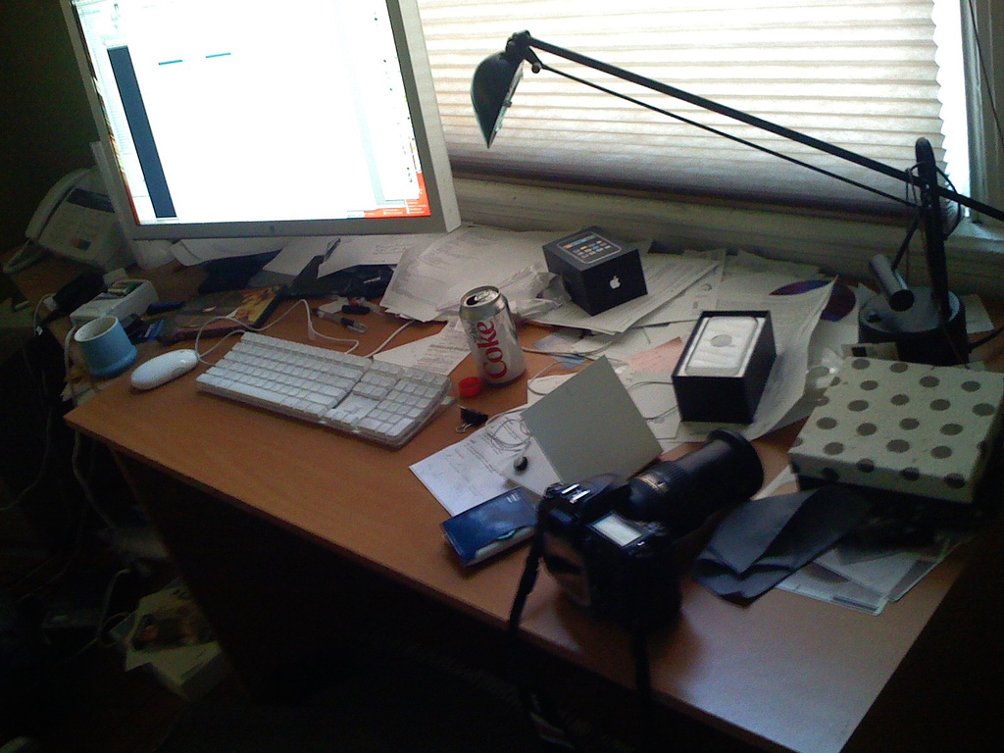
Can you find the coffee mug?

Slide 3
Can you find the coffee mug?

Slide 4
Can you find the coffee mug?

Slide 5
Introduction: Current Aids for the Blind
285 million visually-impaired world-wide
In the U.S. alone:
100,000 use long canes
7,000 use guide dogs
Canes and Guide Dogs provide essential mobility and safety;
Electronic Travel Aids provide the potential to ‘see with sound.’
Pradeep et al., IEEE EMBS, 2010

Slide 6
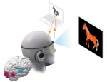
Introduction: Current Aids for the Blind
Canes and Guide Dogs provide essential mobility and safety;
Electronic Travel Aids provide the potential to ‘see with sound.’

Slide 7
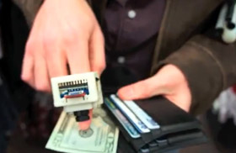
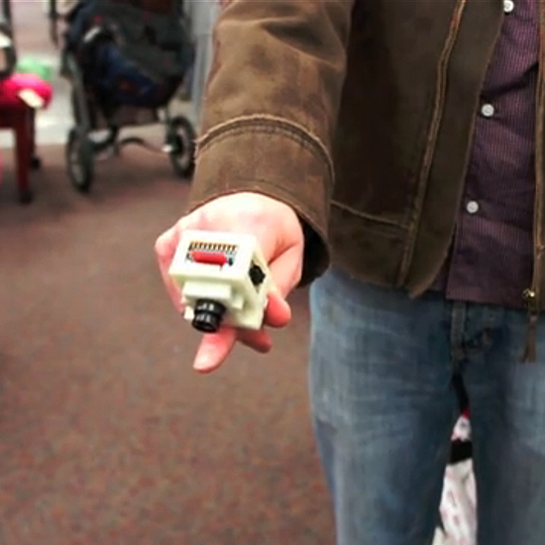
Reading and Recognizing ETAs and Sensory Substitution Devices
Some ETAs even provide real-time object (dollar bill)/color detection (EyeRing) or text-to-speech conversion (ORCam).

Slide 8
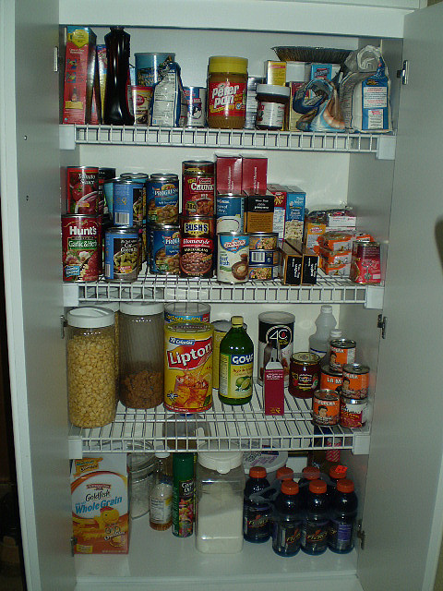
Motivation/Problem Statement
?
However, these may not be helpful in all situations, and none provide explicit object localization/recognition.

Slide 9
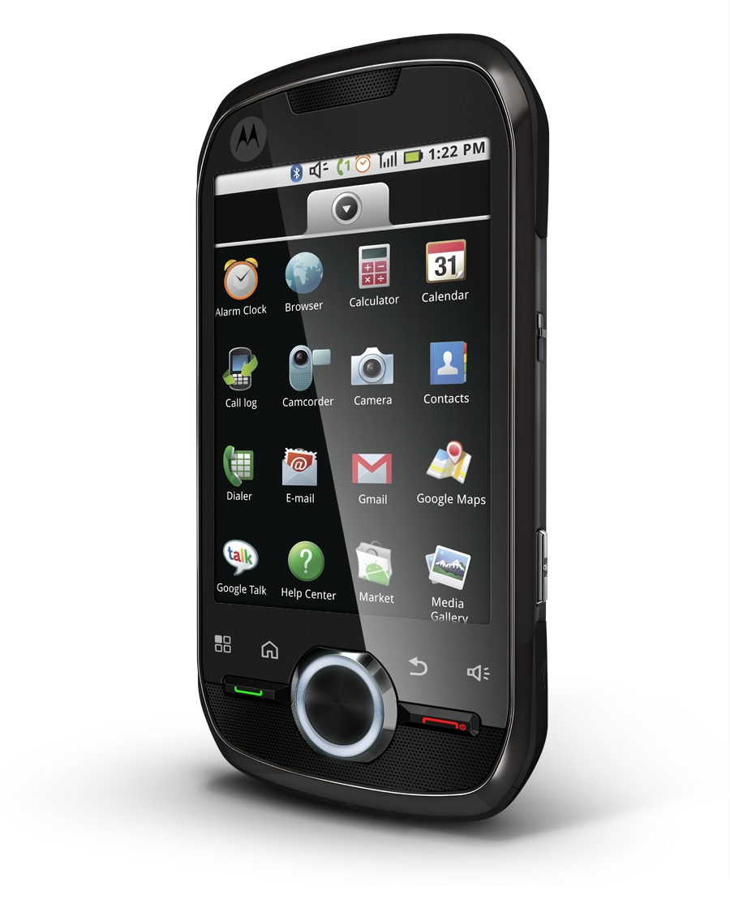
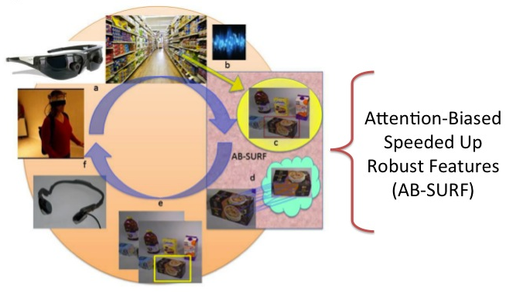
System Overview
Provide explicit object localization and recognition in real-time
Feedback for the user to locate and grasp the desired object

Slide 10
System Components
Head-mounted wide-field-of-view camera to process the incoming scene

Slide 11
System Components
A (mobile-phone-based) voice/touch command module for user query

Slide 12
System Components
Attention-biasing and object recognition computer vision algorithms, AB-SURF

Slide 13
System Components
An object-tracking algorithm

Slide 14
System Components
4:10pm – Evaluation of Feedback Mechanisms for Wearable Visual Aids
Audio feedback to guide the user to the desired object

Slide 15
What Our System Offers…
Compared to…
Our method
1.) Neurally-inspired attention-biasing to narrow the region over which object recognition must compute

Slide 16
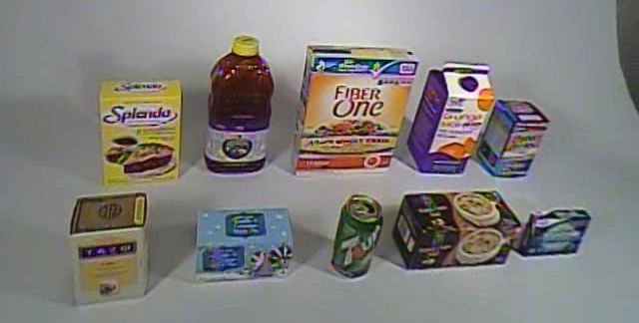
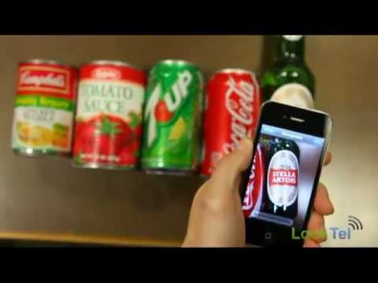
What Our System Offers…
Compared to…
Our method
2.) Analysis of a full scene instead of need to narrow down on object of interest; the algorithm will find the region of interest.

Slide 17
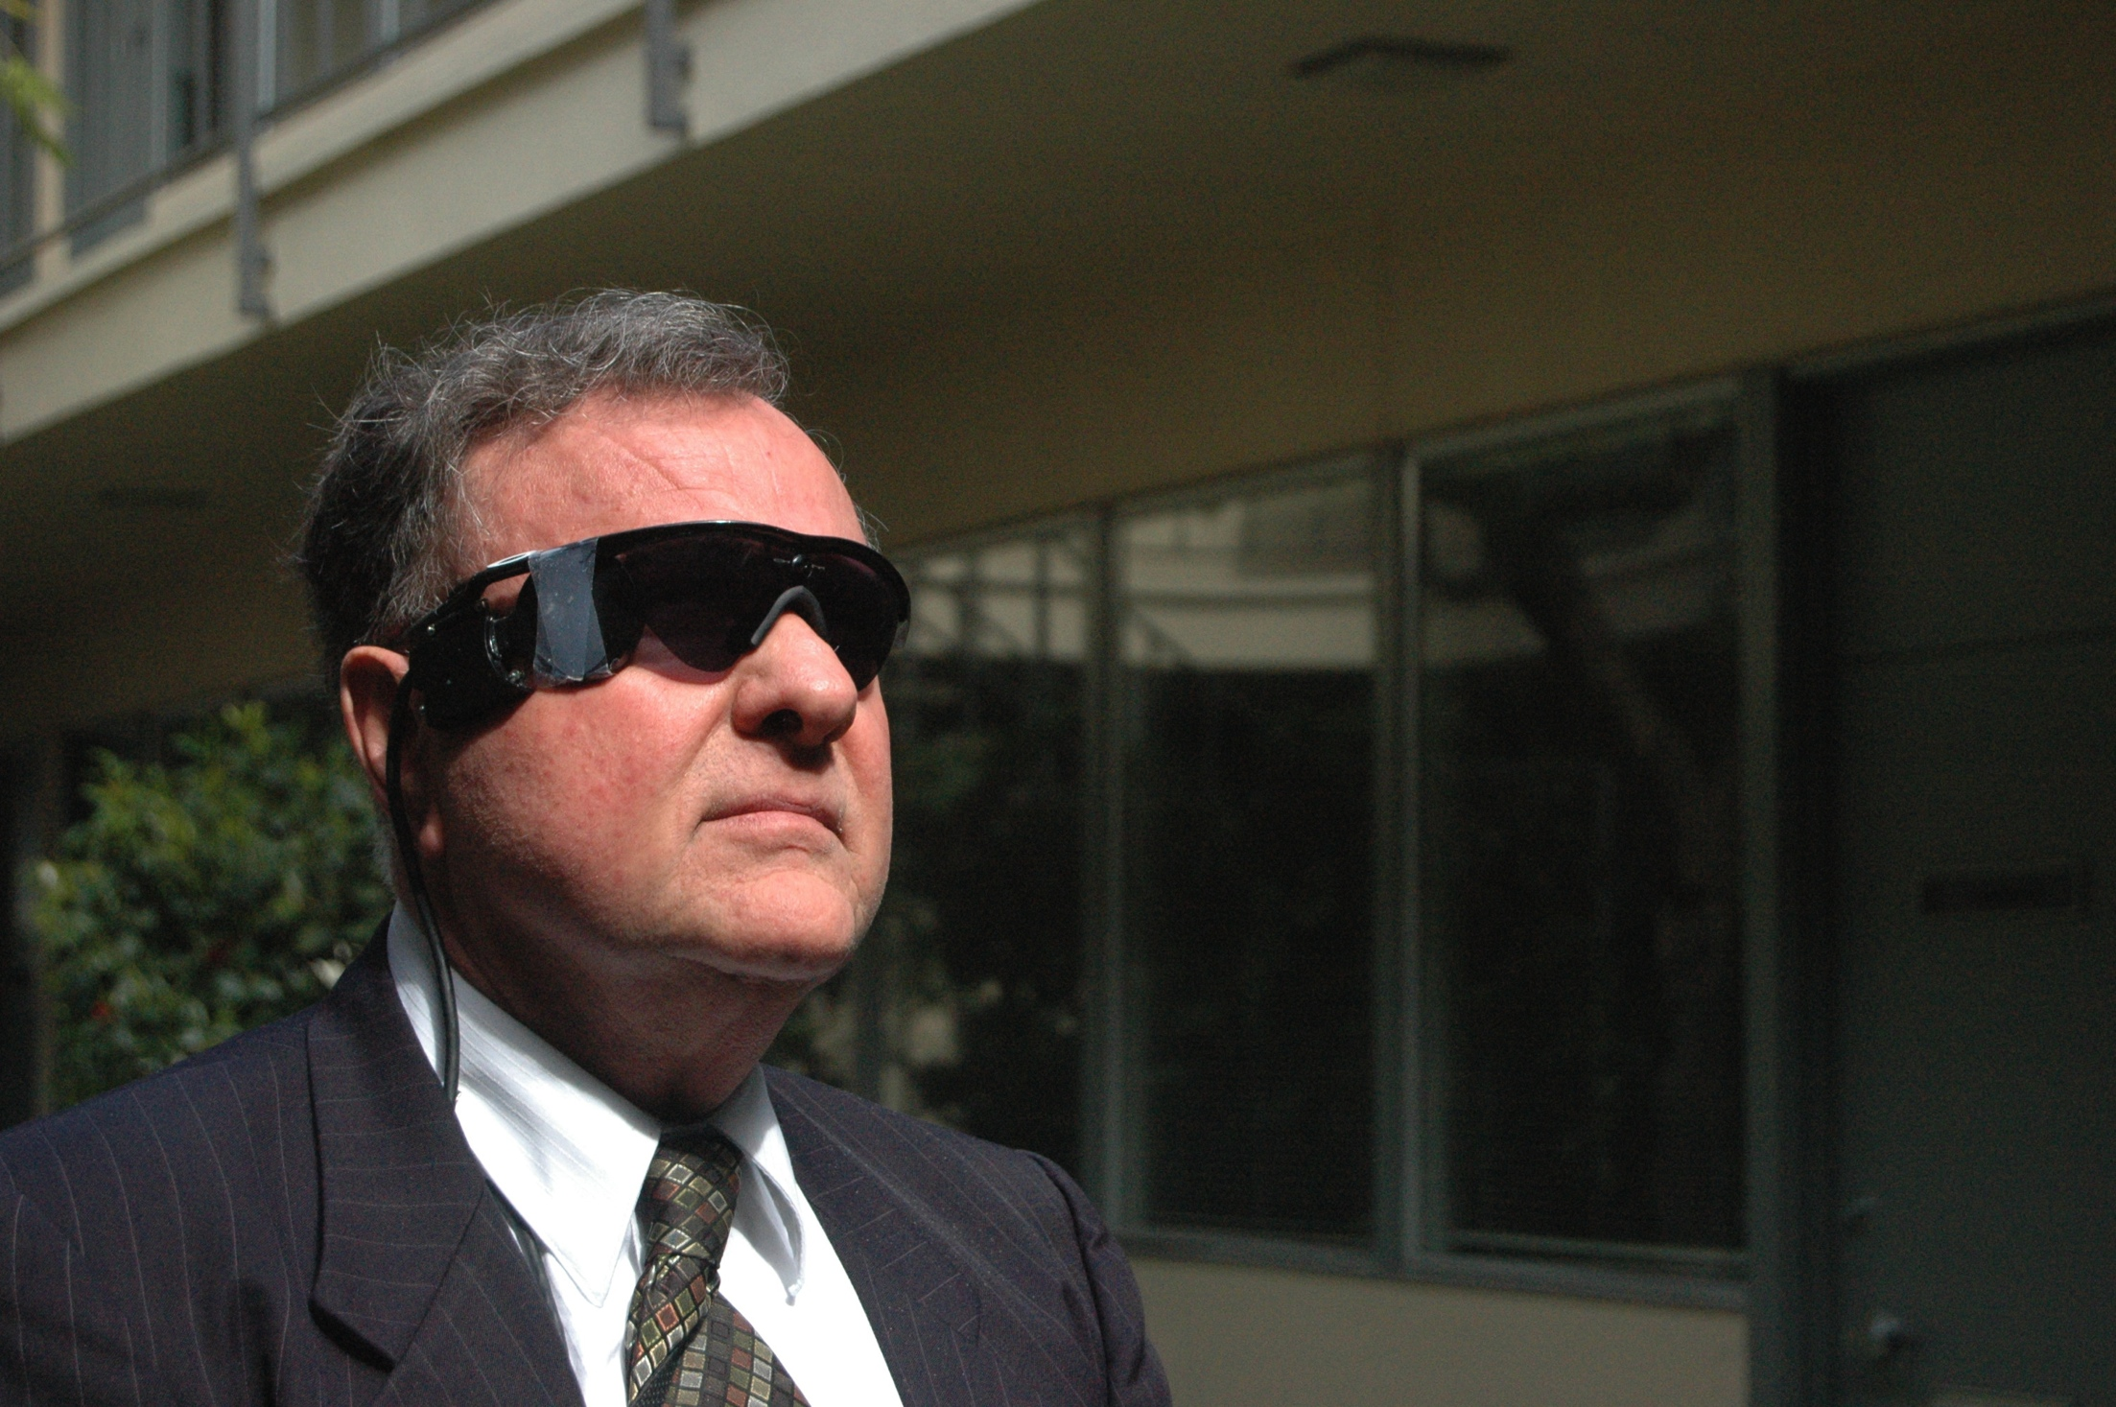
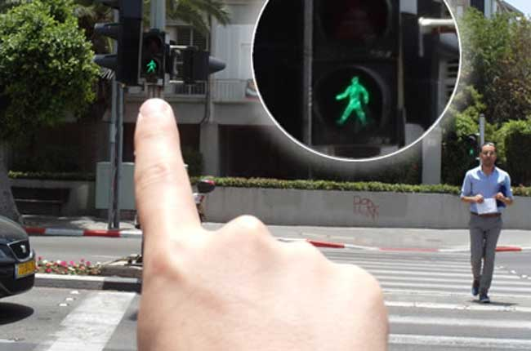
What Our System Offers…
Compared to…
Our method
3.) Scene scanning with ease/efficiency through single camera mounted on glasses.

Slide 18
Attention-Biasing Algorithm Details

Slide 19
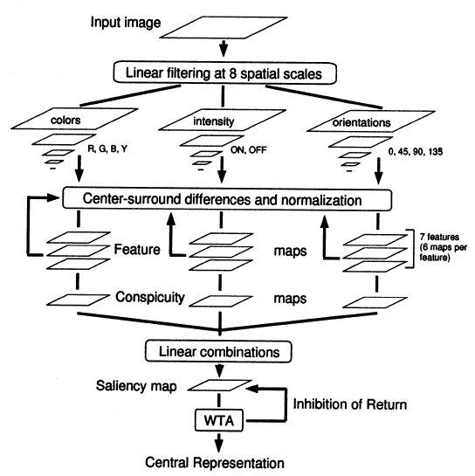
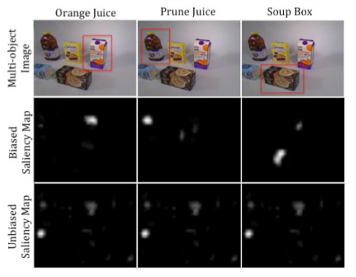
Algorithm Details:
Computing an Unbiased Saliency Map
Itti & Koch, Vision Research, 2000; Navalpakkam and Itti, IEEE CVPR, 2006.

Slide 20
Algorithm Details: Attention-Biasing
As a Method of Segmenting the Image
Itti & Koch, Vision Research, 2000; Navalpakkam and Itti, IEEE CVPR, 2006.

Slide 21
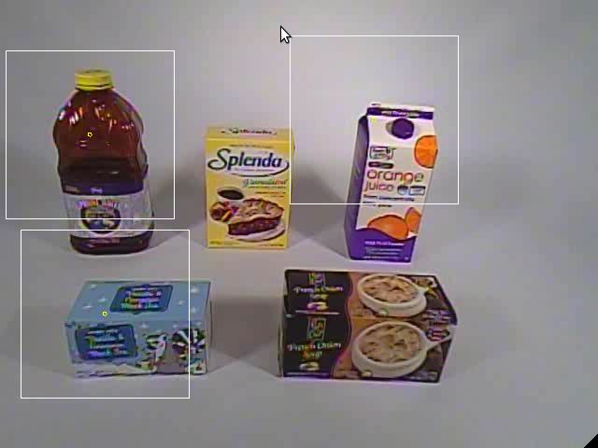
Evaluation of Attention-Biasing in Isolation
5-object case: performance at or above 85% even for 1-fixation location, 96% for 3

Slide 22
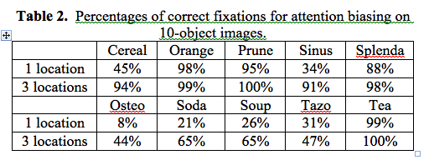
Evaluation of Attention-Biasing in Isolation
For 10-object images: Orange, Prune, Splenda, and Tea exhibit at or above 88% correct fixation even at only 1 fixation point
6 of the 10 objects have performance at or above 91% at 3-fixations
Increasing number of fixations improves rates

Slide 23
Object Recognition Algorithm Details

Slide 24
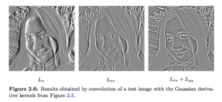
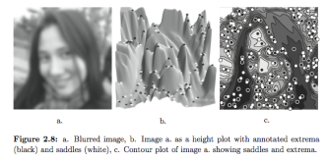
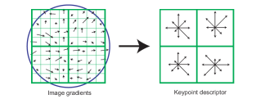
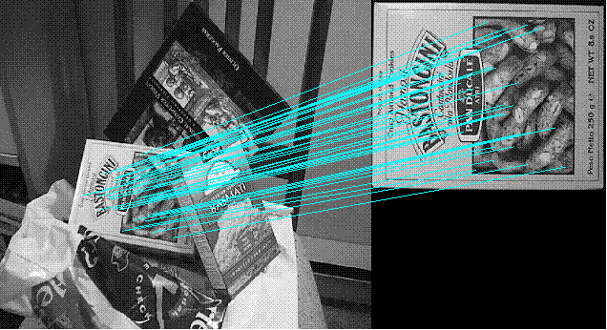
How Does Object Recognition Work?
SIFT and SURF
Invariant to changes in scale, position, rotation, lighting
3 Key Phases
Extraction of Interest Points/KeyPoints
Find the extrema
Description
Gather local gradient information
Matching
Best match has least Euclidean distance
Evaluation Result: SURF > SIFT
Lowe, D.G. “Distinctive Image Features from Scale-Invariant Keypoints.”, IJCV 2004.; Bay et al, 2006.

Slide 25
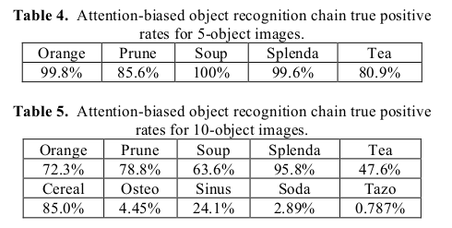
AB-SURF Results
5-object images produce excellent results: 80-100%
10-object images have expected reduction due to lower resolution for each object; 5 of ten objects exhibit accuracy between 63-96%

Slide 26
Conclusions
Concatenating attention-biasing with object recognition via AB-SURF saves computing time while achieving accuracy comparable to SURF (on isolated images) on a cluttered image
640 x 480 pixel image would require ~40 subwindows, 40 seconds
With AB-SURF, we only need 3 subwindows
Speed-up is > 5-fold (AB-SURF ~ 7 sec); even further savings possible through optimizing code/implementing on GPU

Slide 27
Future Directions
Reduce the time needed to compute the hue channels for attention-biasing
DPM (Deformable Parts Model) for object recognition
Adding color information to object recognition
3D: Distance/Range information may be needed to improve generalization
Increase the complexity of dataset images
Add scene-text recognition to improve fine-grain object distinguishing ability
Test the system with visually-impaired subjects

Slide 28
Thank you!
Prof. Gerard Medioni
Prof. Ram Nevatia
Dr. Christian Siagian
Carey Zhang
Nii Mante
Aminat Adebiyi
BRL Lab, iLab, Tanguay Lab
TATRC – Grant # W81XWH-10-2-0076

