Slide 1
Gaps in AssistiveTechnology for the Blind: Understanding the Needs of the Disabled
Amy C. Nau, O.D., F.A.A.O
University of Pittsburgh
UPMC Eye Center
McGowan Institute for Regenerative Medicine
Fox Center for Vision Restoration

Slide 2

Technology provides endless possibilities
for improving the lives of the visually impaired

Slide 3

BUT…
Hitting the mark and actually serving the needs of the
blind requires ------
that you understand the stakeholders.

Slide 4
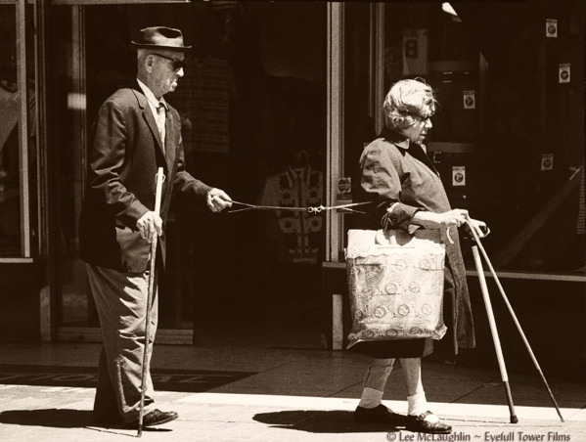
Who are the Stakeholders?
The blind person
Their family or caregivers
Clinicians
Occupational therapists
CMS/government
Insurance companies
Manufacturers/Vendors
Collaborators

Slide 5
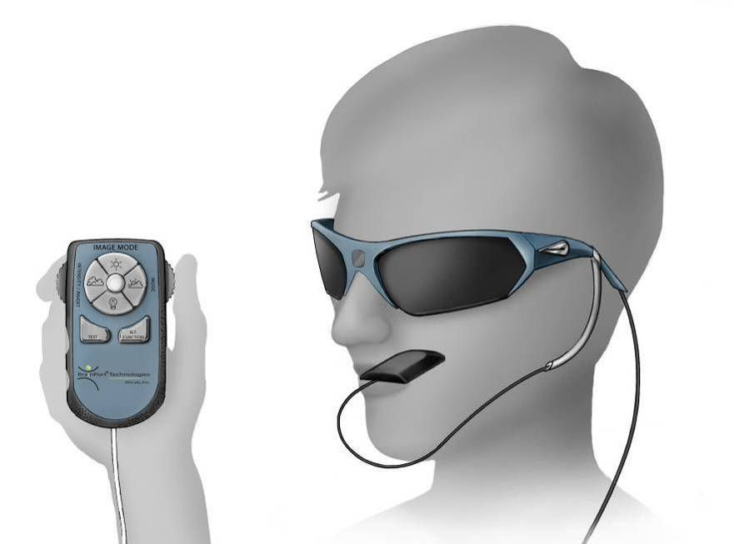
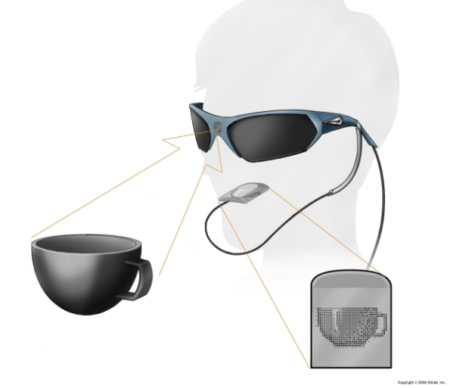
Background- Sensory Substitution
BrainPort Vision Device (Wicab, Inc.)
Uses a mini camera that sends an image to an 400 array electro-tactile tongue display

Slide 6
KDKA video

Slide 7
Studies 2009-present
Veteran’s Study (n=10)
  First home use
  Device Feedback
  Safety Outcome
Outcomes Study (n=30)
  Design and validate outcomes test
  PET/MRI
FDA Safety Study
  70 subjects @ 8 sites, 18 subjects @ UPMC
  Device safety
  Behavioral outcomes
Telerehabilitation Study (n=10)
  Remote/virtual low vision rehabiltation
Enhancing Device Study (n=20)
  Hardware upgrades
  Software upgrades
  CMU/RI
    Facial/object recognition
    Mobility enhancement
    fMRI
SS in Aging
  fMRI in the acquired blind (n=20)

Slide 8
Outcomes Assessments
BaLM
BaGA
FrACT
Visual field (TS)
Object recognition
Word recognition
Depression Screen
QoL (VFQ-25 and AI)
Obstacle Course
EMR
Flash VEP
MRI (DTI/tractography)
PET

Slide 9
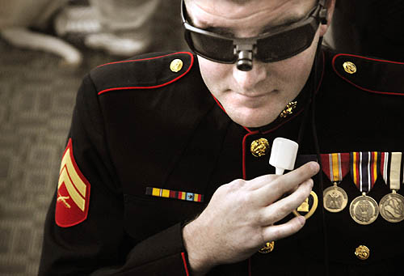
Purpose- understand the gaps
In conjunction with the CMU QoLT, we were seeking information about how AD for the totally blind could be improved and further developed.
Investigate usage patterns of assistive devices (AD)
Investigate satisfaction with current AD
Provide information regarding perceived deficiencies in AD
Provide insight about desired AD attributes and functions
Relate this information to demographic status
Notes:
My goal is to provide you some insights into what the blind community percieves as gaps in current technology. I will share with you today their perceptions of how they are and are not being served by existing blind technologies.

Slide 10
Methods
Single center, cross sectional telephone survey
114 mixed, open ended questions
Activities of Daily Living
Ability to perform activities as relate to blindness
Self –reported level of independence
Work/Recreation
Demographics
Nature of blindness
Education
Health status
Exercise status
Living situation
Adaptation to Blindness
Use of other senses
Methods to compensate
+/- aspects of AD
Gaps in Current Technology
Ability to adapt to novel AD
Wish lists for future AD
Notes:
To the best of our knowledge, this is the only questionnaire which uses demographic information combined with attitudes regarding technology to glean insight into how assistive vision devices are being used by the blind community

Slide 11
Subjects
Recruited from SS Lab research registry
n=76 blind male and female adult subjects (LP or worse bilaterally from any cause)
Average age 52.3years (range 20-80 years)

Slide 12

Results
Educational Attainment
95% at least some high school
25% high school diploma
15% associates degree
12.5% bachelors degree
5% some grad school
7.5% master’s degree
10% doctorate degree
60% Braille literate ***
Notes:
Keep in mind that just because you are blind, you are not uneducated. Many persons who are blind , arrived at this condition later in life. It is more rare to find an older congenitally blind person who has completed their education at the graduate level, but they do exist. While the aged perinatal blind are the most adapted to their condition, technology during their educational years did not really exist.

Slide 13
Results- Lifestyle
37% live alone
  13% of these receive daily assistance from caregiver
87.% exercise regularly
  57.1% exercise outside the home
In 2001, 45.4% of adults in the general population of the United States engaged in activities consistent with physical activity recommendations
Notes:
Our blind cohort seemed to exercise more than the general population.
We found no correlation between duration of blindness, education, self-reported health status and exercise

Slide 14
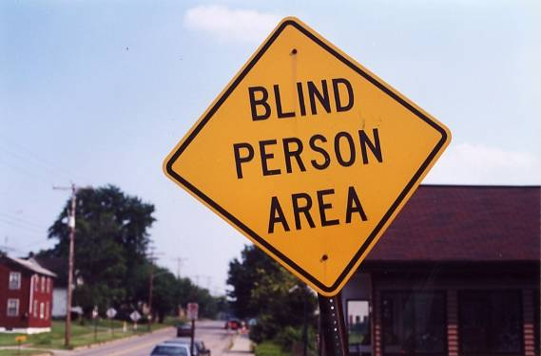
How often do they leave home?
Leaving home (number of times per day)
  20% leave < once
  40% leave once
  40% more than once
Notes:
Firstly, while some people certainly are “holed up” in their homes (and many times these are the folks who have not had adequate training or are newly blind and still very scared), nearly half are leaving the house more than once per day. We found this to be surprising.

Slide 15
Degree to which our respondents felt they were able to function
independently for the listed activities
Activity | totally independent | somewhat independent | dependent
Eat | 90.00% | 10.00% | 0.00%
Bathe | 95.00% | 2.50% | 2.50%
Get dressed | 92.50% | 7.50% | 0.00%
Trim nails | 70.00% | 17.50% | 12.50%
Brush teeth | 97.50% | 2.50% | 0.00%
Distinguish medications | 57.50% | 32.50% | 10.00%
Walk on sidewalk | 60.00% | 30.00% | 10.00%
Cross a street | 40.00% | 27.50% | 32.50%
Navigate stairs | 92.50% | 5.00% | 2.50%
Find a building | 33.30% | 43.60% | 23.10%
Find a room within a building | 32.50% | 45.00% | 22.50%
Read directional/informational signs | 0.00% | 2.60% | 97.40%
Identify currency | 37.50% | 40.00% | 22.50%
Identify products | 32.50% | 50.00% | 17.50%
Use a computer | 58.30% | 22.20% | 19.40%
Reach for an object | 77.50% | 17.50% | 5.00%
Locate a person | 62.50% | 32.50% | 5.00%

Slide 16
Results- Activities
Notes:
This is a busy slide, but it is important.
Things to take home about the activities:
Daily: prparing meals, doing dishes, indoor chores and working- farily common.
Weekly: Grocery shopping, religious services, eating out, doctors, social or cultural events
Never: sporting events, outdoor chores
It is always interesting to ask—why don’t you engage in X. Is it because you can’t or you don’t want to?
Understanding how they spend their time is a critical factor in designing meaningful technologies.

Slide 17
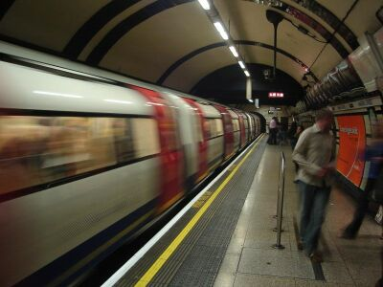
Results-
Transportation
Notes:
Our research subjects are particularly independent. This may reflect their being a group that is overall more adventurous and are early adopters of technology. Many travel domestically and internationally on their own. Additional subjects should be studied to see if these numbers are representative of the blind community at large. However, it is clear that there is heavy reliance on mass transit, taxis, driving services for general transportation needs. Federal and state cuts to transportation services have hit this group particularly hard.
There is a need for non-text identification to aid in traveling (bus stop signs, airport navigation)

Slide 18
Gaps in Mobility
87.2% rely on a cane for ambulation
39% of those surveyed maintained that they walked as their main mode of transport.
9.9% of our respondents said their mobility device (i.e. cane) was their most useful technology
60% of our subjects cannot cross a street without assistance
97.4% are totally dependent on others to interpret directional or other signs
66.7% rely at least partially on others to find a building
17.4% reported that mobility was an issue inside the home
60.0% reported mobility problems outside the home.

Slide 19
Insert video of blind person using the BrainPort
(Lighthouse then Jose Neto)
Notes:
To get a sense of how difficult it can be for a blind person to simply walk down a hallway, let alone navigate through a space to a desired destination, I am going to show you a video of a person who has been deprived of their cane and is using the BrainPort vision device to walk for the first time. I will then show you how this improved after several hours of training. If you want to make a device that is useful for navigation, you need to watch the blind or low vision person trying to get around. It is not pleasant, it can be awkward, too but it is necessary to understand the issues before you can try to solve them.

Slide 20
Results- Employment
50% were employed
  31 % office
  30% management
  15% professionals
  10% educators
  20% laborers

Slide 21
Results - Employment
33% reported no problems at work because of blindness
EMPLOYEMENT PROBLEMS RELATED TO BLINDNESS
Notes:
I think this is an area that needs further exploration.

Slide 22
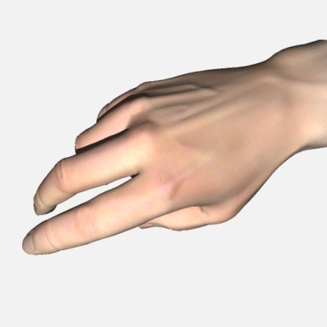
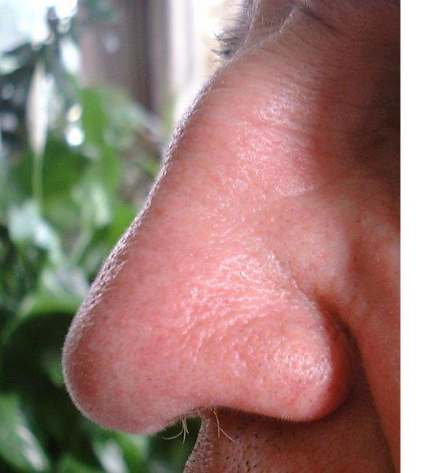
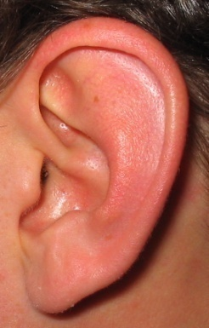
Results Device Usage/Adaptation
Would you sacrifice an intact sense?
50% yes
21% no
29% not sure
How do you identify objects?
Touch 97.5%
Smell 20%
Sound 15%
How do you identify people?
vocal cues 97.5%
Smell 20%
How do you identify places?
Sound 56.2%
Touch 28%
Smell 28%

Slide 23
Attitudes towards Technology
60.0% of respondents use text to speech
12.5% use a cell phone or smartphone
56.4% denied that technology makes them nervous or apprehensive
23.1% reported being uncomfortable with technology.
Notes:
The latter is likely to decrease over time with the increasing prevalence of computer based devices in our culture.
Keep in mind that many people with acquired blindness are elderly!

Slide 24
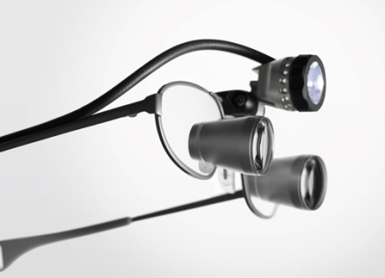
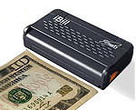
Is it better to have one device or many devices?
General Use 42.4%- more versatile, less expensive fewer devices
Special purpose 36.4%- best performance, less superfluous functionality
No preference 21.2%
53.8% claimed that the number of tasks a device could be used for was “very important”.
Notes:
One of the problems with blind an low vision aids is that many are special purpose. For example, you might have a GPS, a bar code reader and a color detecotor. Both work very well, are accurate and small. However, their use throughout the day requires that they both be carried around. The iPhone has been a complete game changer for low vision and blind applications. Our blind subjects tell us that having one small device with multiple funcitons is preferable. The disadvantage, or percieved disadvantage, is that it may not functiona as well as a task specific device. The other very good thing about the iPhone is that it is “expandable”, meaning that the interface is dynamic, that new applications and functions can be added over time. This fluidity is a really attractive component. The other good thing about this device is it is the same device that sighted people are using , too.

Slide 25
Technology
Advantages
Desired
Improvements
Disadvantages
Literacy
Communication
Recreation
Other
Object ID
interface
Portable
Smaller
Consistency
Reliability
Interface
Other
Interface
Not tailored to blind
Inaccuracy
Not portable
Technical Issues
Battery life
Other
Method for determining type, functionality, advantages, disadvantages and possible
improvements for devices that respondents were currently using.

Slide 26
Advantages of Current Assistive Devices
).
Notes:
f currently used (%using the device)
and any device currently or ever used (% of all devices).

Slide 27
Disadvantages
Not user friendly
Too hard to learn
Unreliable
Cost
Cosmetically unacceptable

Slide 28
Notes:
We wanted to know what types of improvements the blind would like to see in existing assistive devices. 57.1% wanted devices that were more “blind friendly”, again suggesting that iterative design changes using actual blind persons in focus groups are needed among device developers. Closely following at 42.9% was a desire to have more consistent and reliable devices.

Slide 29
Describes more subtle features of a device that might lead to commercial success or failure.
 | Not at all important | Somewhat unimportant | Neither unimportant nor important | Somewhat important | Very important
How well technology meets needs | 0.00% | 0.00% | 3.10% | 9.40% | 87.50%
Versatility | 0.00% | 3.10% | 21.90% | 18.80% | 56.20%
Ease of use | 6.20% | 3.10% | 21.90% | 15.60% | 53.10%
Cost | 15.60% | 6.20% | 34.40% | 9.40% | 34.40%
Attractiveness | 25.00% | 18.80% | 40.60% | 9.40% | 6.20%
Noticeable | 25.00% | 18.80% | 34.40% | 12.50% | 9.40%
How hard it is to learn to use | 25.00% | 18.80% | 25.00% | 9.40% | 21.90%
Frequency of personal maintenance | 28.10% | 6.20% | 12.50% | 12.50% | 40.60%
Frequency of Professional maintenance | 21.90% | 6.20% | 25.00% | 12.50% | 34.40%

Slide 30
specific functions of devices according to their perceived usefulness
 | Function of Device How useful is it? | Current Device | Any Device Used
 | text identification | 80.0% | 45.1%
 | non-text identification | 15.0% | 8.5%
 | communication | 35.0% | 19.7%
 | mobility | 17.5% | 9.9%
 | recreation | 12.5% | 7.0%
 | other | 17.5% | 9.9%

Slide 31
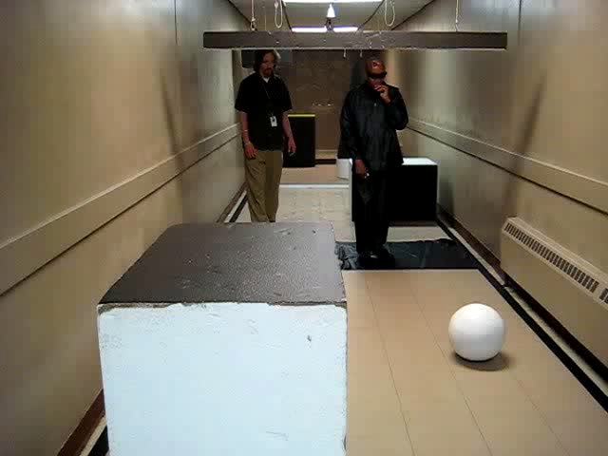
Training- began in earnest in 2011
20 hours –NOT ENOUGH

Slide 32
3 Month f/u--Lessons Learned
Once they get home…..
  Core skills acquired are quickly forgotten
  Intimidation
  Boredom
  Transportation / access is the barrier to returning for additional rehab training
=
Loss of interest
Device abandonment

Slide 33
Barriers to Follow up
Capacity
  -not enough LVOT or providers to provide ongoing rehab sessions
Transportation and reliance on others to get to appointments
Perceived failure of devices due to confusion
Geographic barriers
It is often not known by the clinician whether the patient accepts the recommendations and/or correctly implements them in their home environment.
Notes:
A recent study conducted by investigators at the JHU Wilmer Eye Institute indicated that 38 physicians at low vision rehabilitation centers nationwide were no better than chance when predicting the success of low vision rehabilitation outcomes relative to their patients’ reports of visual function changes [5].
The LOVIT trial showed that low vision patients benefit from additional follow-up after in-office low vision rehabilitation [3].

Slide 34
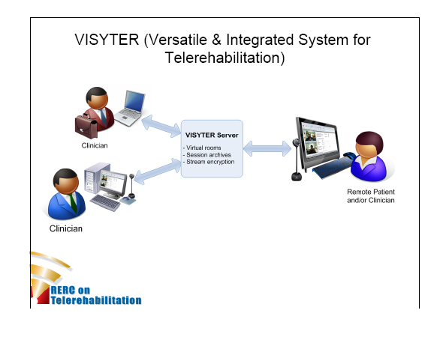
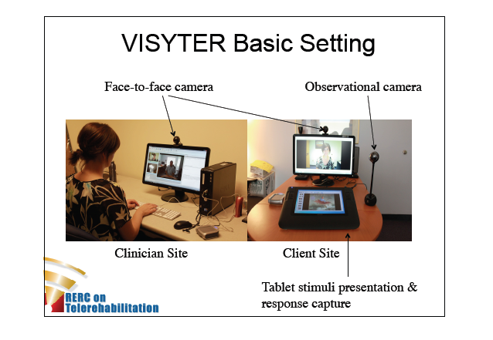
Telerehabilitation – A solution??
TR refers to the delivery of rehabilitation services via information and communication technologies . Rehabilitation services include assessment, monitoring, prevention, intervention, supervision, education,
consultation, and counseling.
Notes:
Here, your stakeholders become the clinicans and LVOT/OT/O&M specialists.

Slide 35
Cost Considerations
Would you pay for an AD? | no | 5.3%
 | yes | 89.5%
 | unsure | 5.3%
Amount would pay for an AD? | 0 - 100 | .0%
 | 101 - 1000 | 5.6%
 | 1001 - 10000 | .0%
 | 10000+ | .0%
 | as much as could afford | 11.1%
 | unsure/budget | 83.3%
Notes:
The reality is that less than 50% of the blind population is gainfully employed. And, fewer are blind with unlimited resources. Many are elderly and live on fixed incomes with high expenses for medications and physician bills. Therefore, careful consideration must be paid to what it will cost to manufacture and distribute/market your product or device. One of the main reasons that low vision services are not more effective is because, in this country, low vision devices are not covered by insurance. In our low vision service, less than half of the subjects will follow through with low vision rehabilitation if they have to pay out of pocket for their own low vision aids. Joan Stelmak found similar results in her Low Vision Rehab survey among a VAMC population. These are not expensive, generally a few hundred to few thousand dollars for a CCTV.
Your stakeholder here becomes CMS/the government and insurance companies. You will have to think about proving the benefit of your device in order to justify the payment. For example, will your device allow people to walk more safely and reduce the risk of fall accidents? A broken hip costs, on average, about $80,000 to fix. If you can prove that your device will reduce the number of hip fractures in the blind, then you might have a chance. The accountants do not really care about humanitarian causes. Other stakeholders here become the caregiver, as they may be the person paying for the device, the clinician who might recommend the device and the manufactuers, with whom you must work to keep your overhead low.

Slide 36
Summary
Current assistive devices do a fairly good job at facilitating literacy
enhancing mobility or interpretation of the environment (i.e. signs) are a huge gap.
The blind seek devices that are tailored to their needs, reliable, easy to use and are not prohibitively expensive

Slide 37
Summary
Engage with the blind community
Each stakeholder plays a vital role in the success of your project
Get continuous feedback from everyone all the time
You want to hear that you are wrong!!

Slide 38
Joel Schuman
Kevin Chan
Chrissie Pintar
Christopher Fisher
Jacki Fisher
Valeria fu
Dongsheng Yang
Rich Hertle
Aimee Arnoldussen
Rich Hogle
Charles Laymon
Vincent Lee
Matthew Murphy
Yaser Sheikh
Yair Movshovitz-Attias
Amy Rebovich
Ken Wojznik
Mark Kislan
Deborah Fenton
Pam Howe
Melissa Lowalkowski
Judith Shanahan
Wendy Chen
Tobin Vijayin
Jenna Sembrat
Julie Steinbrink
Alex Keifer
Cody Wolfe
Kathleen Janesco
David Moffa
Myles Nightingale
Courtney Elvin
Daniel Chen

Slide 39



Acknowledgments
National Institutes of Health CORE Grant P30 EY008098
Eye and Ear Foundation of Pittsburgh, PA
Unrestricted Grant from Research to Prevent Blindness, New York, NY
Defense Medical Research and Development Program (DM090217), Department of Defense, USA
Fine Foundation
DCED State of PA
Louis J. Fox Center for Vision Restoration- OTERO
Lion’s Club
Aging Institute University of PIttsburgh

