Slide 1


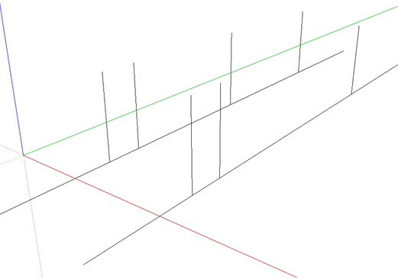
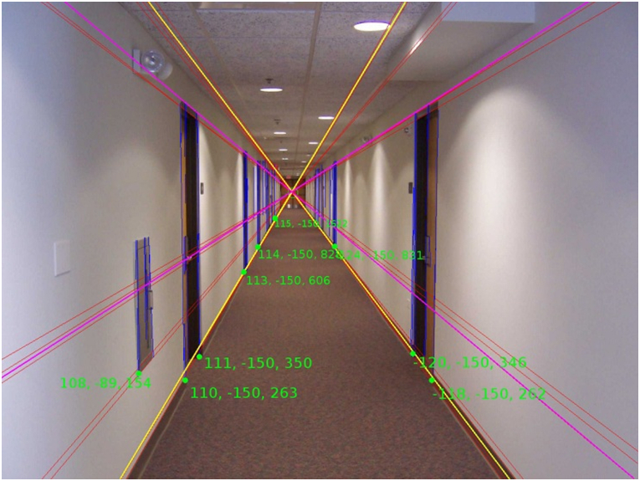
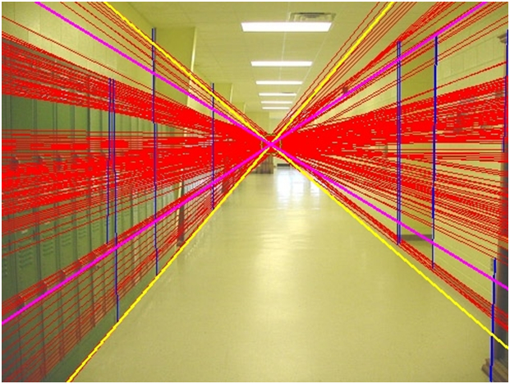
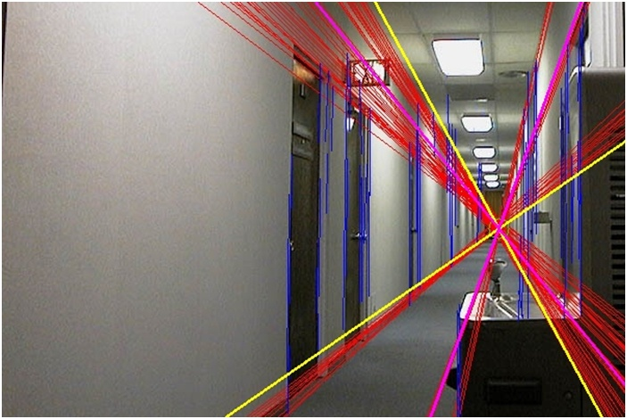
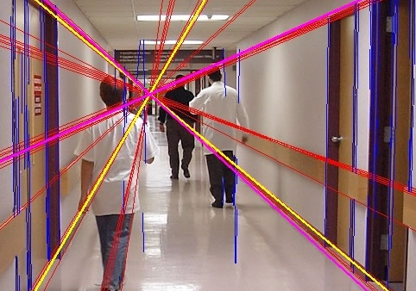
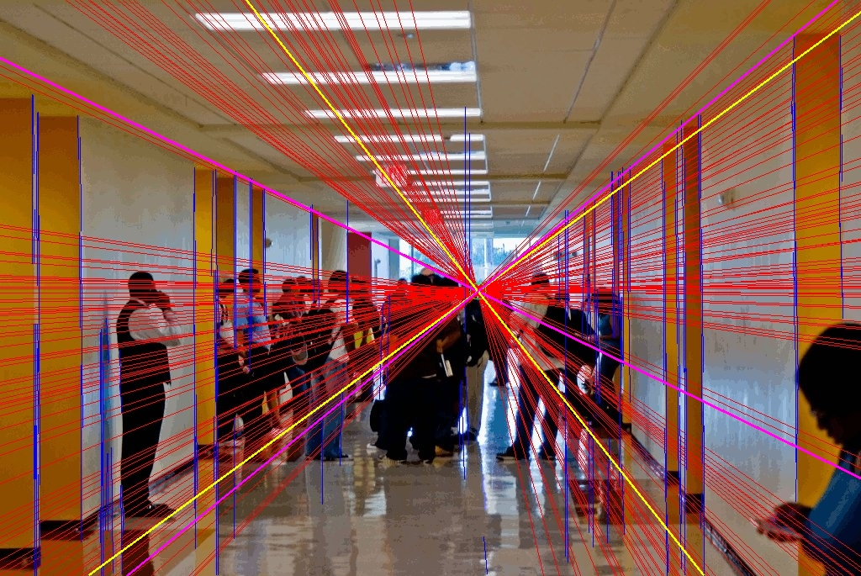
3D Hallway Modeling Using a Single Image
Greg Olmschenk and Zhigang Zhu
Department of Computer Science, CUNY Graduate Center and City College
Abstract
Approach
Real-time, low-resource corridor reconstruction using a single consumer grade RGB camera is a powerful tool for allowing a fast, inexpensive solution to indoor mobility of a visually impaired person or a robot. The perspective and known geometry of a corridor is used to extract the important features of the image and create a 3D model from a single image. Multiple 3D models can be combined to increase confidence and provide a global 3D model. This poster presents our current work and results on 3D corridor modeling using single images.
Approach: While there are plenty of differences from one hallway to the next, the property of having (mostly) straight walls makes the single image processing possible.
The lines which define the boundaries between the floor to the walls and the walls to the ceiling are lines that go to the vanishing point.
Lines that are perpendicular to the hallway (e.g. doorframes, floor tiles, etc.) will not go to the vanishing point.
Basic Steps to perform the reconstruction:
We begin by performing a canny edge detection .
The result is then put through a Hough transform to produce a map of lines. We are able to determine that the position of the vanishing point will be where the most lines from the Hough transform converge.
From here, we search for surface features, parallel lines which do not run towards the vanishing point. This is done using a perspective based Hough transform (PBHT) which retrieves line segments.
A perspective based Hough transform (PBHT) Algorithm: In the hallway image there may be strongly defined lines (such as doorframes) far down the hallway, yet they would be normally excluded from a regular Hough transform because these lines are so much smaller than lines physically closer to the camera. To account for this, the Hough transform adds a weighting biased towards objects closer to the vanishing point. The line segments found serve two purposes.
First, the line segment will lie on one of the surfaces, so the end of this segment can be used to estimate which line that passes through the vanishing point defines the boundary between one surface to the next.
Second, the line segment can be used to find features. The most obvious example of this is the line that outlines a door or connecting hallway. From this information, a 3D wireframe model of the hallway can be built.
Motivation
In the world built by humans, hallways are everywhere. As such, there are many cases where the information about the corridor is important.
Hallway detection is an important component for any indoor navigation system including those used by the visually impaired, and can be used to help visually impaired people avoid the walls as well as find the doors and cross section corridors necessary to take them to their destination.
A mobile robot needs to be able to navigate its environment. If that environment involves the inside of a building, it’s likely the robot will frequently encounter hallways.
The most common way to extract the information on a corridor in computer vision currently is to use a range sensor and perform the computations necessary to find the walls of the corridor.
Unfortunately, these methods require relatively expensive equipment, heavy processing, and high energy consumption. This makes the method impractical for a robot that needs to move quickly, a wearable system that need to be built cheaply, or a blind person who doesn’t want to carry a laptop on their back processing data all day.
The most recent relatively low-cost 3D sensors are the RGB-D sensors, such as Microsoft Kinect and Asus Xtion Pro, but their sensing ranges are quite limited (0.5 to 4 meters) and are not very suitable for corridor detection.
We propose a high speed, low resource, inexpensive solution to these needs. Effective portable corridor detection capabilities with nothing more than a single consumer camera such as a webcam or the cameras found on a smartphone.
This is done through the detection, localization and 3D reconstruction of corridors from individual images, while multiple images can provide more detailed and confident information.
Furthermore, as the RGB camera does not have a range limitation as the range sensors do, another example is using the methods described here combined with data already retrieved from range sensors to make assumptions about what the camera can see beyond the range sensors limits.
Progress and Results
Our current progress consists of successfully extracting useful 3D data for a corridor model from a single image.
Some of this data can be seen visualized in the images below. In these images, the red lines are the relevant lines running to the vanishing point, the yellow line are those which are the detected transitions between the floor and the walls, the purple lines are the detected transitions from the walls to the ceiling, and the blue lines are detected wall feature lines. The data from the first corridor image has also been annotated and used to generate a 3D wireframe model (right).
While the current implementation is not perfect, it validates the potential of the approach. In virtually every case, the floor to wall transitions are detected with reasonable accuracy. Most of the false positives given in the below examples are in the detection of the wall features and are expected to be remedied by combining wireframe data from multiple successive images.
Conclusions
We have a presented a real-time, low resource 3D corridor reconstruction method from a single camera.
The perspective based Hough transform algorithm allows for the fast and reliable reconstruction of accurate 3D models with low resources.
With this, the current approach should be useful as an aid to the visually impaired as both a standalone approach as well as a method used in a combined approached.
Future Work
Create reliable single image 3D reconstruction of corridors using a smartphone;
Use multiple reconstructions to increase confidence and get absolute distance information;
Case studies to rigorously test and compare the accuracy, speed, and resource consumption of the methods described here in comparison to other common methods;
The integration of these methods with existing methods and technologies.
Acknowledgments
This work is partially supported by US National Science Foundation Emerging Frontiers in Research and Innovation Program under Award No. EFRI-1137172.
The proposed future work of this thesis has been granted a PSC-CUNY enhanced research grant (Award # 66786-00 44).
Additionally, the members of the CCNY Visual Computing Lab have given continual support and help.

