Slide 1
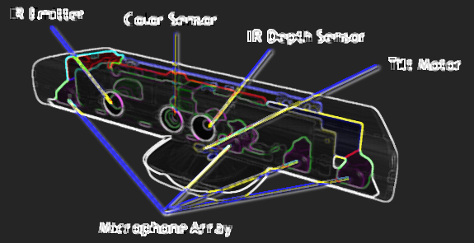
KINECT FOR INDOOR NAVIGATION
Alpha Diallo | Edgardo Molina | Wai L. Khoo | Hao Tang, Ph.D | Zhigang Zhu, Ph.D
Motivation | Goal
Obstacle Avoidance Algorithm
According to WHO data, there are 285 million visually impaired people alive today, 39 million of whom are fully blind
Autonomous mobility is one of the most vexing challenges facing this demographic
We explore using commodity RGB-D sensors to build a navigation system that allows the visually impaired to move about safely within indoor environments
Depth data smoothing: $[x, y, z] [x, y, z’]$
Stream depth data frames through fixed-size queue buffer
Reduce noise: for each 3d pixel $\left[x, y, z\right]$, set depth value $(z)$ to mode $(z’)$of corresponding depth values within the buffer
Floor plane estimation and filtering:
Map pixel coordinates to real world
Estimate and filter out 3D points belonging to floor plane
3D to 2D obstacle map: $[x, y, z’] [x, f(z’)]$, where: $f\left(z^{′}\right)= \frac{z^{′} ∗ Y}{Zmax}$
Navigate simpler 2D obstacle map:
Partition FOV into 3: Left (L), Front (F) and Right (R)
Scan L and R only when obstacle found within F
Alert user when obstacle detected within 2m distance
Suggest appropriate course correction
System Architecture | Features
System:
XBOX Kinect 3D sensor: head or belt-mounted
Commodity PC for data processing: backpack-mounted
Features:
Obstacle detection and avoidance for safe navigation
Human skeleton and face tracking to alert user about surroundings:
Track and follow specific person
Enumerate people within field of view
Collision avoidance, etc…
Vocal alerts and feedback
Floor Plane Estimation
3D Data to 2D Obstacle Map
Publications
E. Molina, A. Diallo, Z. Zhu, (2013) "Visual noun navigation framework for the blind", Journal of Assistive Technologies, Vol. 7 Iss: 2, pp.118 - 130
A. Diallo, E. Molina, M. Goldberg, Z. Zhu “Using Kinect to Empower Visually Impaired Individuals to Explore Unfamiliar Environments”, Hot3D (ICME 2013)
Acknowledgements
This work is supported by the National Science Foundation under Award # EFRI - 1137172

