Slide 1
Computer Vision Project Topics
CSc I6716
Spring2011

Slide 2
Project Reports
Introduction (problem –Why, with real-world applications)
Related Work (What has been done, with a few references)
Your Approach (How you are going to do it, with algorithms, equations, figures)
Your Implementation and Analysis (What you do, with images, tables, and numbers)
Your Conclusions (Itemized conclusions, observations and discussions)
All Reports in hard copy due May 17, 2011 before class (hard deadline)
Each student has 10 minutes (8 talk +2 QA) x 15 students = 2.5 hours

Slide 3
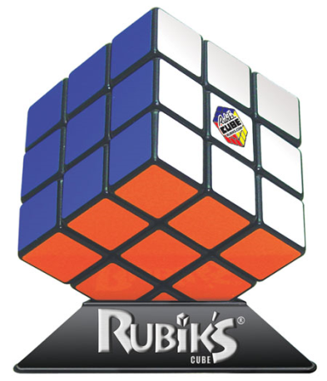
Rubik cube recognition
Team
Jay Junjie Yao
Felix Cen
Wahyu Jati Nugroho
Key Components
Edge detection: an initial detection of the cube object
Color detection: scan the color cells for each visible side
Feature extraction: detect all small squares and cube features (3D localization and orientation)
Implementation
Java and OpenCV (JavaCV)
You need to specify contributions of each (3x)
Notes:
1. Topic:
Rubik cube recognition
2. Introduction:
Rubik cube is one of the famous toys in the world. Solving the Rubik cube puzzle has emerged as a benchmark for service robots. Detecting the edges, colors, and features of the Rubik cube is required as the basic tasks for building an input for the robot algorithm.
3. Scope:
Below are the set of limitation and goal for this project:
1. Edge detection: an initial detection of the cube object
2. Color detection: scan the color cells for each visible side
3. Feature extraction: detect all small squares and cube features (localization and orientation)
The algorithm for solving the puzzle and translating the algorithm into robot movement are optional tasks. It is not the main task of this project.
4. Implementation:
Programming Language: Java
Libraries:
OpenCV: http://code.google.com/p/javacv/
LEJOS: http://lejos.sourceforge.net/
5. Evaluation:
Get the correct cube object.
Find the correct color for each visible side.
Get the correct features of the cube.
Solve the puzzle by using a Lego robot (optional).
Project Member:
Jay Junjie Yao
Felix Cen
Wahyu Jati Nugroho

Slide 4
Car recognition in images
Team
Nikolaos Markou
Key Components
object learning and recognition
Where is 3D and perspective geometry?
Implementation
Maybe car distance and orientation estimation?
A Robust Shape Model for Multi-View Car Alignment Yan Li, Leon Gu, and Takeo Kanade The IEEE International Conference on Computer Vision and Pattern Recognition, June, 2009.
Notes:
Professor,
I would like to do a project regarding object learning and recognition. Specifically I want to do a project that deals with car recognition in images (or video if I can get it up to there). Please let me know if you think this is going to be extremely difficult to research and implement in one month.
Thank you,
Nikolaos Markou

Slide 5
Image searching
Team
Jianfang Li
Could you team up with Nikolaos Markou?
Key Components
The project is to find a target image from bunch of images by scale-invariant feature transform (SIFT)
This is too broad and vague, lack details
How does this have anything to do with 3D vision?
Are you dealing with perspective distortion?
Notes:
Professor, The following is description for my final project. Member: Jianfang Li Final Project Topic: Image searching
The project is to find a target image from bunch of images by Scale-invariant feature transform.
If you have any suggestion, please let me know.
Thanks,
Jianfang

Slide 6
Detection of possible cancer using computer vision
Team
Carlo Garcia
Razia Sultana
Key Ideas
A High Resolution picture of a histology slides and a pathologist uses some staining techniques under a microscope to determine the average intensity by sections of the high resolution image.
How can computer vision help?
Image registration of images before and after?
Notes:
Hello Professor, Razia Sultana will join me for my project. Please approve. My project is Computer Vision: Cancer Identification on Prostate Samples This is a real world problem to help pahtologist easily measure and identify Potential Cancer on Prostate Samples - Measuring Intensity Levels of each partition of Cancer Sample - Use Morphing as a tool to help Identify Cancer. We may Morph only the cancer section of the sample.. - By knowing the properties of cancer, We may use other strategies learned in class to immediately identify cancer cells (such as invasive cancer, cancer that spreads into nearby healthy tissue). Carlo
Professor, I'm still undecided for my project but this is what I got so far. I spoke to a scientist at my job about detection of possible cancer in a human sample (prostate or breast tissue sample) using computer vision. He said that they use techniques to determine if the sample has cancer or not. Right now, they have pathologist to do the job. Here's what I got from him. Basically, a High Resolution picture of a histology slides and a pathologist uses some staining techniques under a microscope to determine the average intensity by sections of the high resolution image. I saw this website http://bmi.osu.edu/~cialab/organizers.html that is similar to what I want to do but very much less complex. I don't know much about biology but I'm just afraid that this topic may be too complex since some pattern recognition and biology are also involved. I guess what I'm trying to do is somehow help pathologist to make their life easier by detecting cancer section on a high resolution image using computer vision. Have you had a student before that had a similar topic as this one? Do you think it will be too complex? Carlo

Slide 7
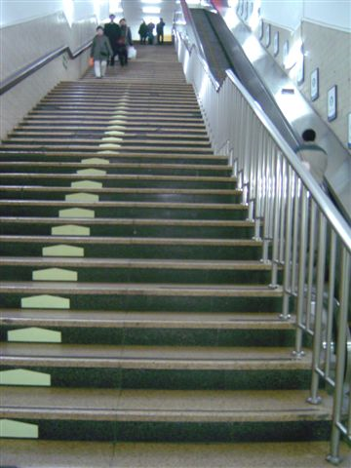
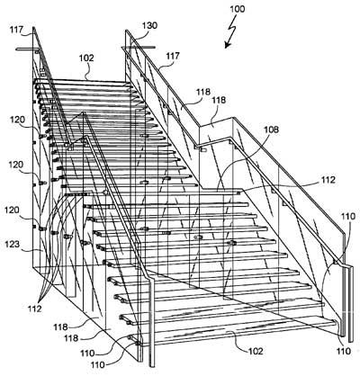
Detection of stairs
Team
Franqueli Mendez
Key Ideas
Line detection
Parallel lines
Stair models
3D estimation
Comments
Obstacle and face detection are too common and hard
Notes:
Professor Zhu,
Here are some of the ideas I came up with for a project.
Obstacle detection from the viewpoint of a moving car
-- Detection of speed bumps and their distance
-- Detecting potholes
-- Detecting objects crossing in front of the car, people, other cars at intersections
The application for all of these would be for use by some sort of driver alert or warning system.
These could also be used by autonomous vehicles for obstacle avoidance.
Detection of stairs
-- either from the view point of stairs that will take you up or those that take you down.
Detecting stairs that go down seems like a harder problem but would be interesting because most of the papers I've seen deal with the other case.
Face Detection
-- Detecting a smiling face
This is a feature in some newer camera's that is used to determine when to actually take the picture
From all of these the two I think I would most like to work on are detection of objects crossing in front of the path of a moving car or detection of stairs in a scene.
-- Franqueli Mendez franqueli@gmail.com

Slide 8
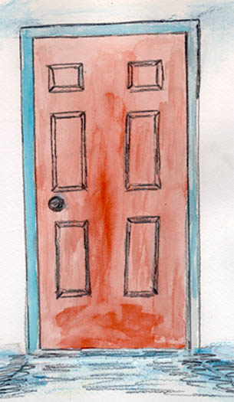
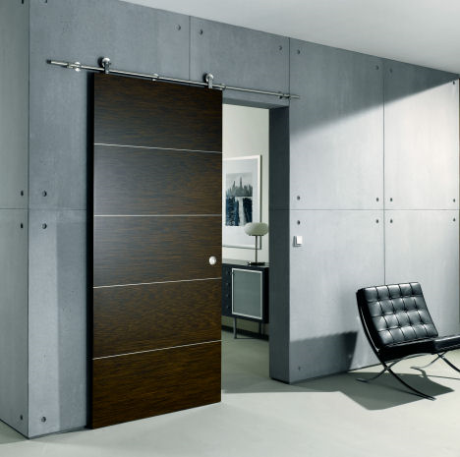
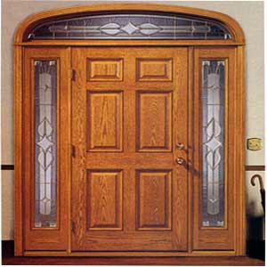
Door detection
Team
Hengyu Ji
Key Ideas
Features:
Lines, qualdrilaterials?
Perspective distortion:
Position and orientation?
Notes:
Dear Prof.Zhu and TA, Here is something about my tentative project. The title of the project: Some kind of detection The names of the team member: Ji Hengyu Describe: Due to my comparably familiar lessons of Computer Vision is Feature Extraction, I would like to take a project which uses it. Doing some kind of detection, such as door or something regular shaped. Target: Write a project report which includes Introduction, Related Work, Approach, implementation, Conclusion and References. Regards Hengyu Ji Delete

Slide 9
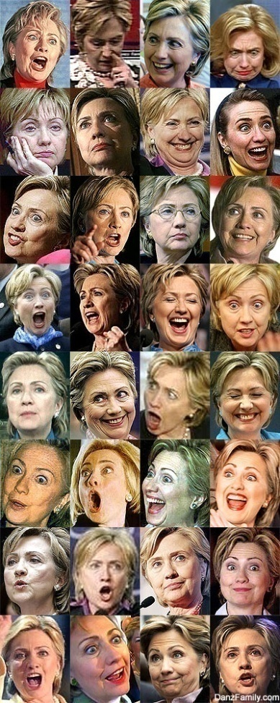
Face orientation estimation
Team
Jose Maldonado
Project Ideas
1. Face Recognition
2. Bar code reading system
Implementations
Lack details
Detection face orientations ?
Many Faces of Hillary Clinton
Notes:
Hey Professor,
Here are my ideas for the Class project:
1. Face Recognition
2. Bar code reading system
Jose Maldonado

Slide 10
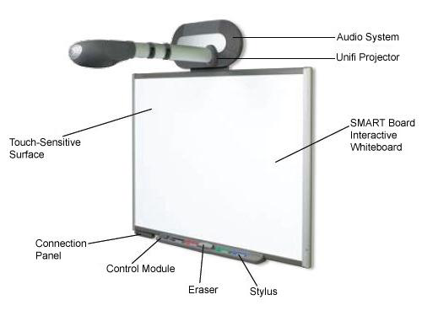
Vision-based smart board
Team
Omar Olivo
Project Ideas
interact with a projection screen using a laser pointer projected on the screen
use Kinect to create better interactivity with the screen when teachers are in front of the classrooms
Notes:
I am suggesting a system that will allow the teacher to interact with a projection Screen using a laser pointer projected on the screen. A regular web cam, positioned just under the projector, will detect the location of the laser on the screen to control the mouse. Once you can manipulate the mouse using the laser, a virtual set of tools can be available to write on the screen, change pen’s color, width, etc. This system will allow teachers to interact with the computer anywhere in the room. On other hand, with the SmartBoards you need to be in front of the classroom to interact with the touch board.
Ideally, I would like to use Kinect to create better interactivity with the screen when teachers are in front of the classrooms. Using the Kinect, I would recognize a finger to control the mouse. But most importantly, we can create a multi-touch interactivity using the 3D information provided by the Kinect.

Slide 11
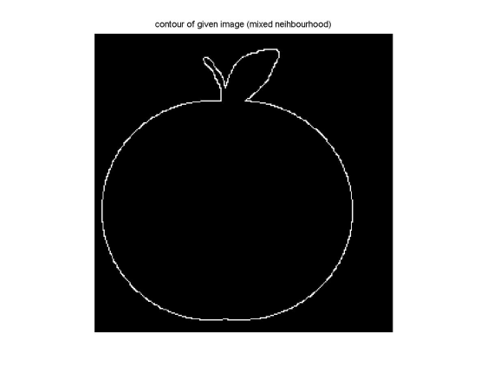
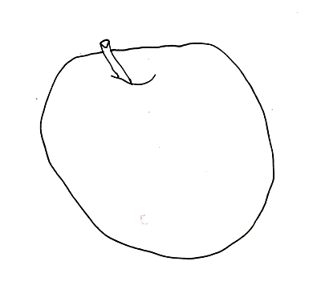
Fast object recognition by standardized edge templates
Qiang Li
step1: make a standardized template library (all fruit, 51x51) step2: extract individual object from a image and generate a single line edge (contour???). step3: standardize the image(normalized, single line, 51x51). step4: use the central point as fix point, clockwise scan the two template images (contour projection?). step5: choose a tolerance value(3 or 5 pixels) to evaluate the image with each template, and get a score (contour matching). step6: decide what kind of fruit it is by lowest score.
Next step
Relational template library
Notes:
Dear Professor, I has determined my project. --------------------project name---------------------- Fast object recognition by standardized edge templates --------------------team member----------------------- Li Qiang --------------------Description----------------------- step1: make a standardized template library (all fruit, 51x51) step2: extract individual object from a image and generate a single line edge (closed, with nothing inside). step3: standardize the image(balanced, single line, 51x51). step4: use the central point as fix point, clockwise scan the two template images (200 lines). step5: choose a tolerance value(3 or 5 pixels) to evaluate the image with each template, and get a score. step6: decide what kind of fruit it is by lowest score. --------------diversify my idea----------------------- when the image go complicated, we can use a relational template library to solve it. for example, what relates to a road most is vehicles, traffic lights, signs, and next is the buildings beside the road, and what less related is the bridge over the road. so those relations can narrow the searching field significantly. but the library is too complicated, so I won't consider it in my project. --------------Project description ends---------------- Could you offer me some advices? Thank you! Best regards, Li Qiang

Slide 12
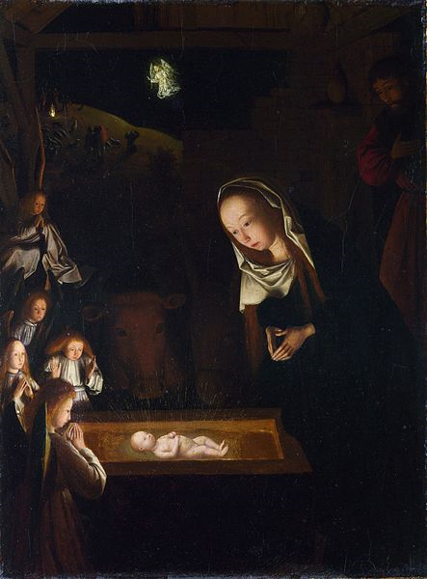
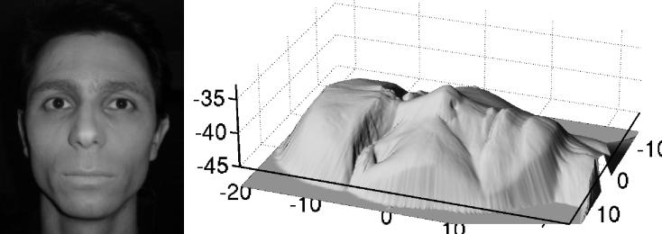
Renaissance Painting & Computer Vision
Monica CONCEPCION
chiaroscuro style paintings featuring intense darkness/brightness together
Tasks
identify objects in paintings that are done in the chiaroscuro style
Shape from shading?
Nativity at Night by Geertgen tot Sint Jans, c. 1490, after a composition by Hugo van der Goes of c. 1470. Sources of light are the infant Jesus, the shepherds' fire on the hill behind, and the angel who appears to them.
Notes:
Professor Zhu -I think that I have an idea for a project. I can identify objects in paintings that are done in the chiaroscuro style i.e paintings featuring intense darkness/brightness together. I can add to this project by choosing let's say paintings of fruit or bread etc. and trying to identify the texture of the object using the light and shadow. Please let me know if this sounds ok. Also, I have been trying to research texture identification in images and am wondering whether it is known by another term rather than texture identification. I will be working by myself and I can call this project "Renaissance Painting & Computer Vision"
Thanks,
Monica
This will be the shape from shading problem. Check Chapter 2 Basic Radiometry (2.2. 3) and Chapter 9 Shape from Shading (9.2) of our textbook or google the information online
-Prof. Zhu
Professor Zhu -I have been researching different topics for the final project. I really want to do something with painting, in particular Renaissance painting since it ties a lot into different topics we covered in class in particular the camera model and 3d to 2d images etc. I am having trouble with figuring out what exactly to do with the idea though i.e how to make this into a project. Do you know of any good topics, experiments that have been done with paintings in computer vision? I keep researching, but am not coming up with a whole lot. I remember in class you mentioned that some of your previous students worked with paintings, what exactly did they do?
Thanks for your help,
Monica

Slide 13
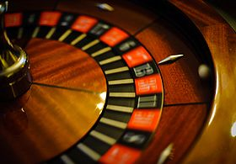
Estimating Roulette game outcome based on multiple images
Team
Lior Baron
Key Ideas
Use 3 images of the system in motion, and an image of the roulette wheel to map out the section of the wheel.
Estimate the ball position speed.
Estimate the rotation speed of the roulette wheel
Estimate the section of the roulette wheel in which the ball will make contact first.
Implementation
use HD videos posted on youtube to get screen captures and test
Notes:
Professor Zhu, For my project in the computer vision course (I6716) I would like to estimate possible outcome in a game of Roulette based on pictures taken over short time (Probably 3 images over 1 second). The purpose of the images will be: - Estimate the ball position speed. - Estimate the rotation speed of the roulette wheel - Estimate the section of the roulette wheel in which the ball will make contact first. For my analysis, I will use 3 images of the system in motion, and an image of the roulette wheel to map out the section of the wheel. I will use HD videos posted on youtube to get screen captures and test my analysis based on the outcome of roulette spin. Lior

Slide 14
Project Reports
Introduction (problem –Why, with real-world applications)
Related Work (What has been done, with a few references)
Your Approach (How you are going to do it, with algorithms, equations, figures)
Your Implementation and Analysis (What you do, with images, tables, and numbers)
Your Conclusions (Itemized conclusions, observations and discussions)
All Reports in hard copy due May 17, 2011 before class (hard deadline)
Each student has 10 minutes (8 talk +2 QA) x 15 students = 2.5 hours

Slide 15
End

